Slide 1

Substance Use in CPCI
Identification, Prevention, and Management Support Tools
June 5, 2019

Slide 2
CONFIDENTIAL
This file contains information that is confidential to Azara Healthcare, LLC
Do not view, copy, distribute, or disclose without prior consent.

Slide 3
Why Are We Here?
Increase knowledge base about CPCI data tools
Promote a deeper understanding of CPCI functionality
Think through data-driven options which promote care team efficiency
Notes:
Good Afternoon, my name is Ava Rose and I work within the Quality, Technology and Initiatives department at CHCANYS. On the line with me is LuAnn Kimker, Director of Clinical Innovation at Azara Healthcare. Welcome and thank you for joining us for this 2 part webinar series on the CPCI SUDs module.
Health center patients are complex and present with a multitude of needs, demanding a coordinated response on the part of the care team. Those needs can be, for example, of a medical nature, can be behavioral in origin or socially determined. More often than not patients’ needs are a combination of all three and more. The CHCANYS QTI department continues to explore promising practices and data analytics tools health center staff can use, to help respond to patients’ complex needs in a manner that is integrative – leveraging the skills of providers, behavioral health clinicians, dental folk, nursing etc. A component of the bench strength that NYS FQHCs have in this area is access to the functionality and tools contained in the Center for Primary Care Informatics. I am excited to be working with LuAnn to provide you with insight on how the CPCI SUDs module can be used to identify patients at risk for substance use, track and manage SUDs patients and assess the impact of treatment with patients with active substance use issues such as opioids. We will cover this today. Next week, during part two of this webinar series, health centers using the SUDs module will present their practices and discuss how they leverage these CPCI tools to underpin their SUDs workflows.
Lastly, please pose questions when asked and provide feedback on what you hear, I am working with LuAnn to develop a user tool to accompany this series and want to ensure that it reflects your real-life concerns and observations about the module – to create a truly actionable document. LuAnn and I are also working together to offer some remote technical assistance to health centers who have the module. I will talk more about this next week. Now I will hand over to LuAnn.

Slide 4
Agenda
1 | Challenges
2 | Understand the Population
3 | Program Management
4 | Performance and Reporting
5 | Questions
UPDATE

Slide 5
CHCANYS Centers with Substance Use Module
Acacia Network | Mosaic Health
Betances Health Center | Neighborhood Health Center Buffalo
Callen-Lorde | NOCHSI
Cerebral Palsy of North Country | North Country Family Health Center
Cornerstone Family Healthcare | Settlement Health
East Hill Family Medical, Inc | The Chautauqua Center
Family Health Network | Trillium Health
Finger Lakes Health | UPC-Southern Tier Community Health Center
Health Care Choices | Urban Health Plan

Slide 6
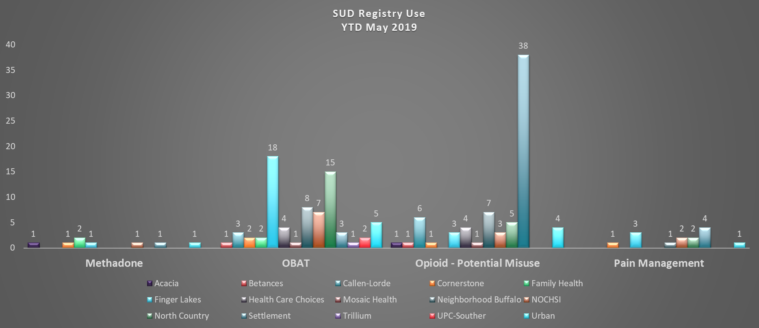
Registry Use

Slide 7
Measures in SUD

Slide 8
Questions
How long have you had a MAT program?
  <6 months
  6-11 months
  1-2 yrs
  >2 yrs
How many patients are in your MAT program?
  <20
  21-50
  51-99
  >100
How many waivered providers do you have?
  <5
  6-10
  >10
What would help you to use the substance use tools in CPCI?
  Additional data validation
  Resources
  More prescription data
  Training
  Better workflows

Slide 9
Managing Your Substance Use Treatment Program
One of the greatest resources people cannot mobilize themselves is that they try to accomplish great things. Most worthwhile achievements are the result of many little things done in a single direction.
– Nido Qubein

Slide 10

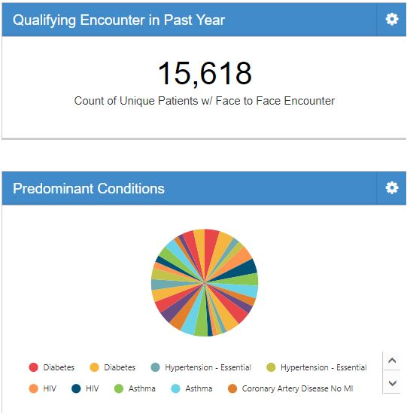

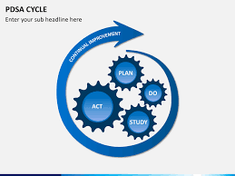
Controlled Substance Management Module
Early identification of patients at risk for alcohol and substance misuse
Tracking and Management of High Risk Populations
Monitoring High Risk Medication Use
Assess the impact of education and changes to workflow on number of patients with active opioids or in treatment

Slide 11
Who Benefits from this Module
Primary Care and Behavioral Health Providers
Care Manager
Care Coordinators
Community Health Workers
Behavioral Health Workers
LCSWs
Patients

Slide 12
CPCI Can Help You to Be Successful!
Identify patients for whom you are prescribing medication assisted therapy (MAT)
Tools that support both primary and behavioral health
Manage the clinical and behavioral health care for patients in MAT program
  Urine drug Screen
  Infectious disease screening (HIV, HepC)
  Mental health Screenings – Depression, anxiety
  Behavioral Health Appointments
Monitor patients at risk and prevention
  General Screening Rates – SBIRT, drug, alcohol, depression
  Benzo / Opioid
  Chronic Opioid Therapy
  Chronic Pain
Program management
  Initiation and engagement rates
  Retention
External reporting/audits
  Monitor provider prescribing of MAT
  Bureau of Narcotics
  Department of Health
Notes:
Challenged with how to integrate the treatment of patients with substance use disorders into your primary care practice?
Overwhelmed with reporting requirements that need to be done manually?
Want to improve the treatment and management of patients with chronic pain?
Tired of double documentation and managing your OBOT program in Excel?
Want to understand opioid prescribing practices better?

Slide 13
Resources in DRVS
Reports
  Controlled Substance Report
Measures
  Drug Use Screen
  Unhealthy Alcohol Use
  Unhealthy Alcohol Use & Counseling
  AOD Initiation of Treatment 13+
  AOD Engagement 13+
  Initiation of Pharmacotherapy – OUD (13-17)
  Initiation of Pharmacotherapy – OUD (18+)
  OUD Treatment
  AUD Treatment
  Buprenorphine Prescription
  Naltrexone-Injectable Prescription
  Opioid and Benzo
  Opioid on Med List
  CTRL Substance Agreement (CNMP)
  Benzodiazepine Usage
  Benzodiazepine Dose > 3mg
  Hep C Lifetime Screen
  Hep C Screen – OUD
Registries
  Office Based Opioid Treatment
  Opioid Medication – Potential Misuse
  Methadone Medication
  Pain Management
Custom Dashboards
Custom Registries
  Opioid dependence with drug screen and bup

Slide 14
Understand the Population

Slide 15
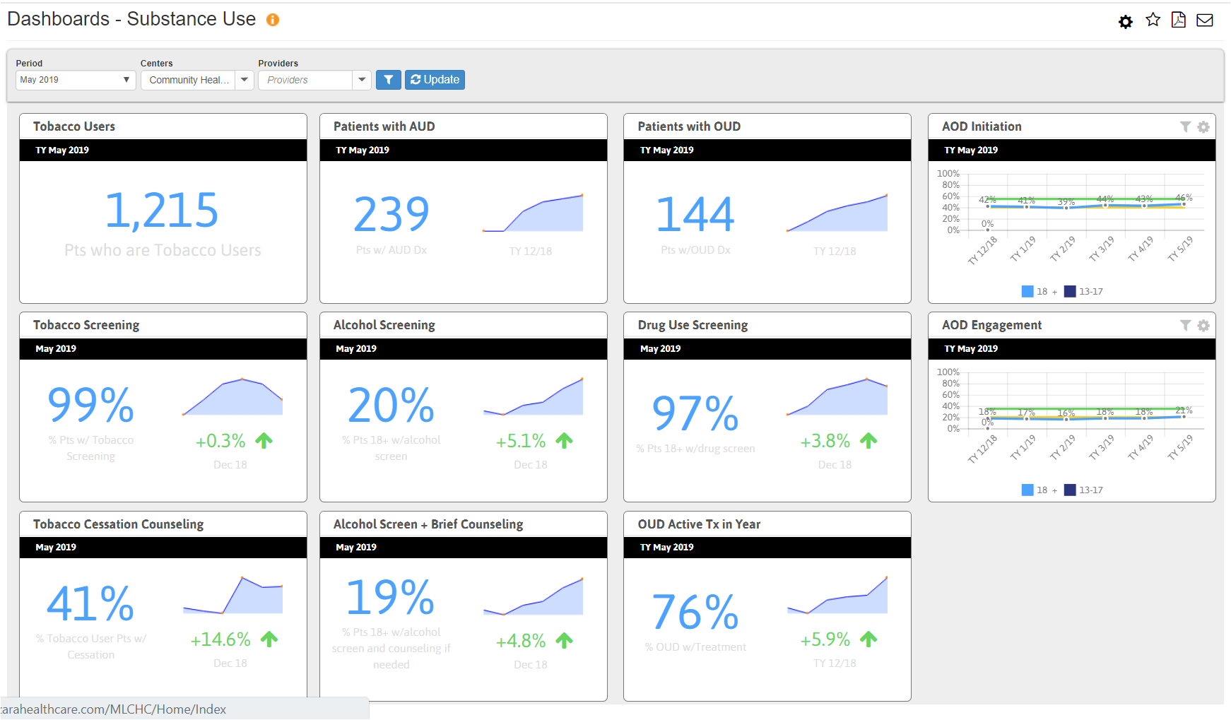
Substance Use Overview for Your CHC

Slide 16
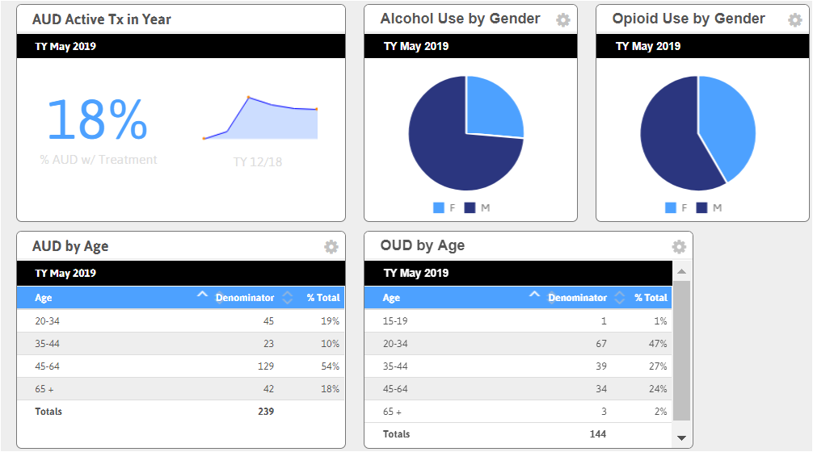
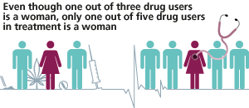

Slide 17
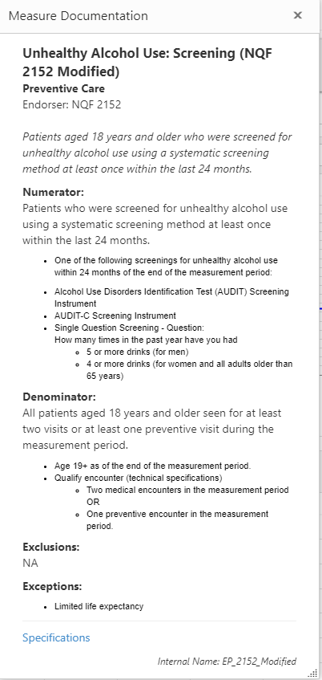
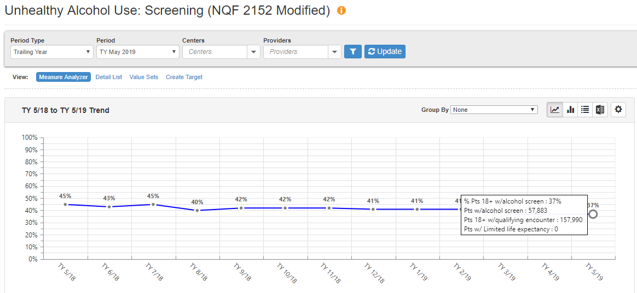
Early Intervention | Alcohol Screening

Slide 18
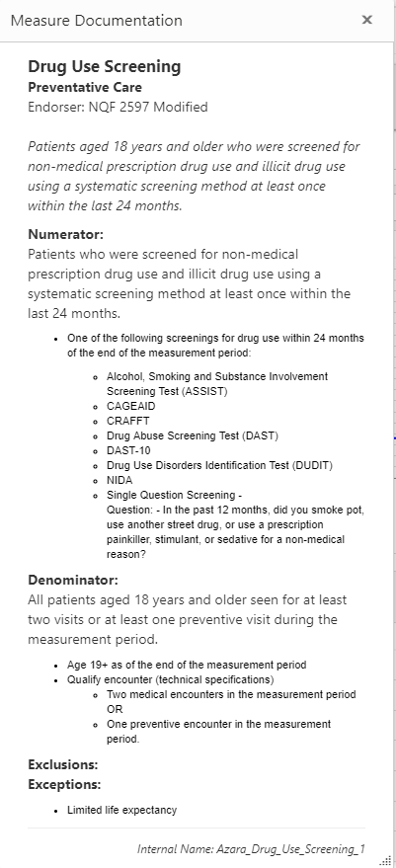
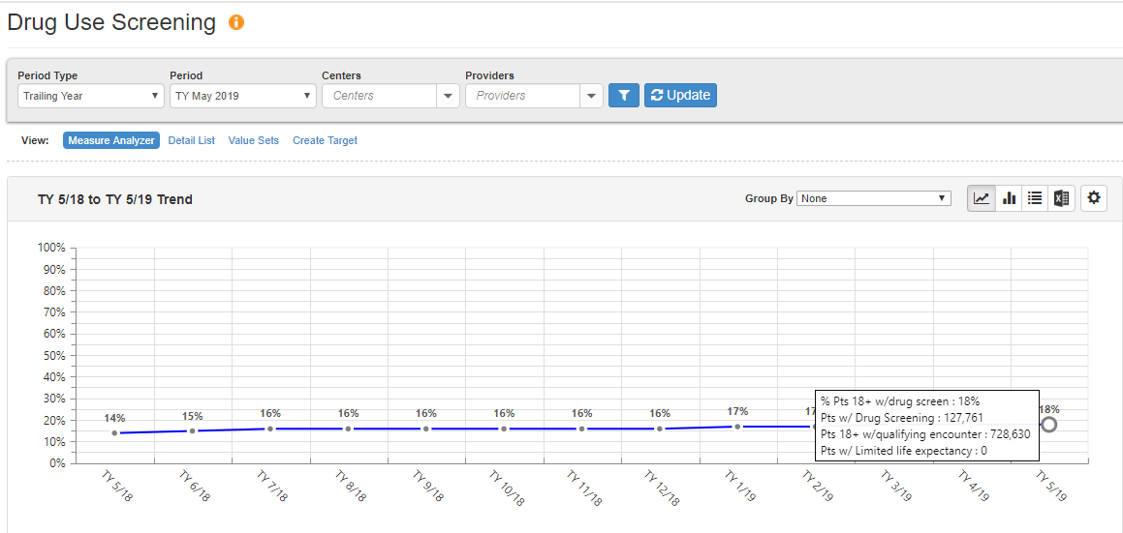
Early Intervention | Drug Screening

Slide 19
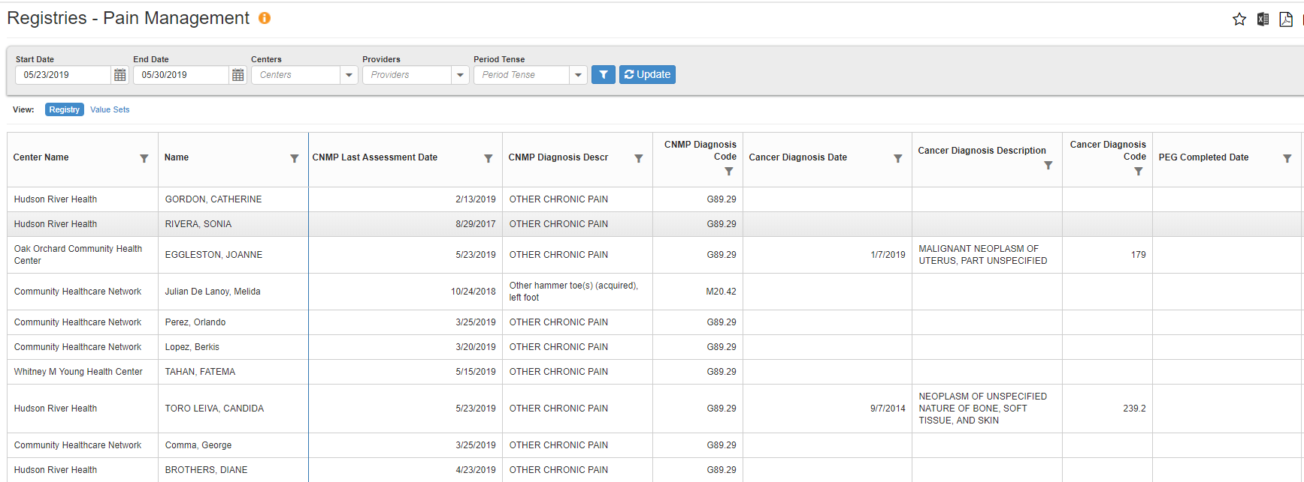
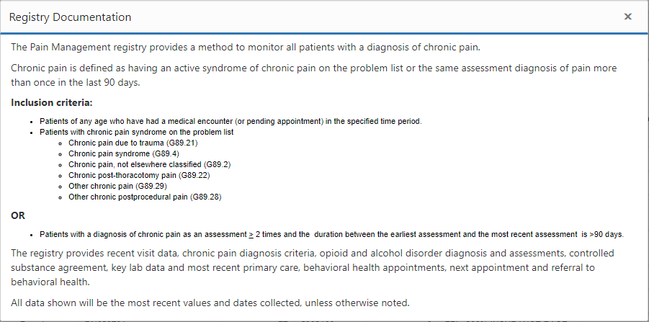
Early Intervention | Chronic Pain
  Identify patients with CNMP and Drugs of Abuse Test
  Assess patients with concurrent conditions/medications
  Evaluate for needed screenings
Notes:
CNMP dx w/o stop date or with controlled substance agreement; start date of opioid does it have an end date

Slide 20
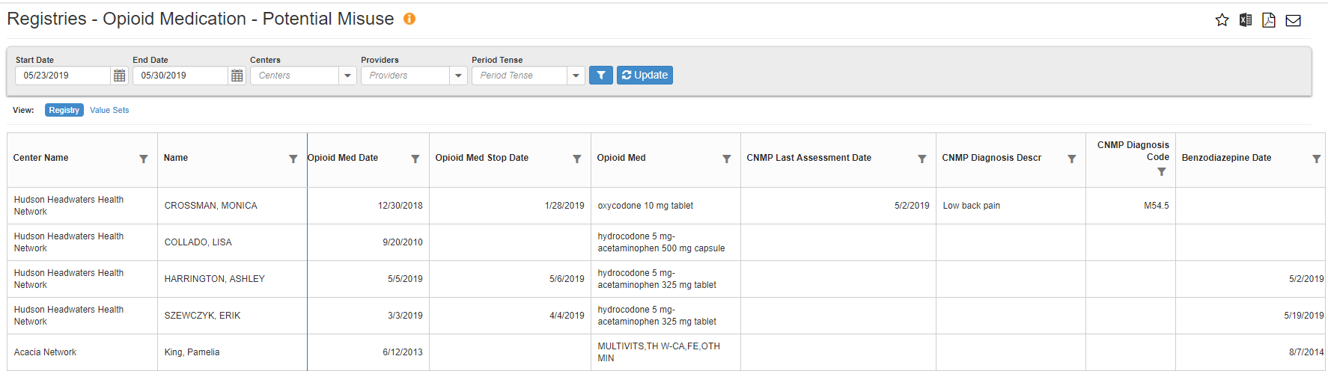
Getting Started: Identify Potential Misuse
Identify:
  Patients with an active opioid prescription and no stop date
  Patients with chronic opioid use and no OUD diagnosis
  Concurrent conditions and diagnoses, i.e. alcohol use disorder, positive PHQ-9 scores, tobacco use, chronic nonmalignant pain, etc.
Notes:
Dirty Data

Slide 21
Managing Patients

Slide 22
MAT Program Management
Identify patients for and manage MAT program
  Active Patients (cohort)
  Adherence
  Continuity
Track Controlled Substance Agreements
Monitor adherence to workflows and treatment protocols
Coordination with other services
  Behavioral Health
  Referrals
  Primary Care
  OB

Slide 23
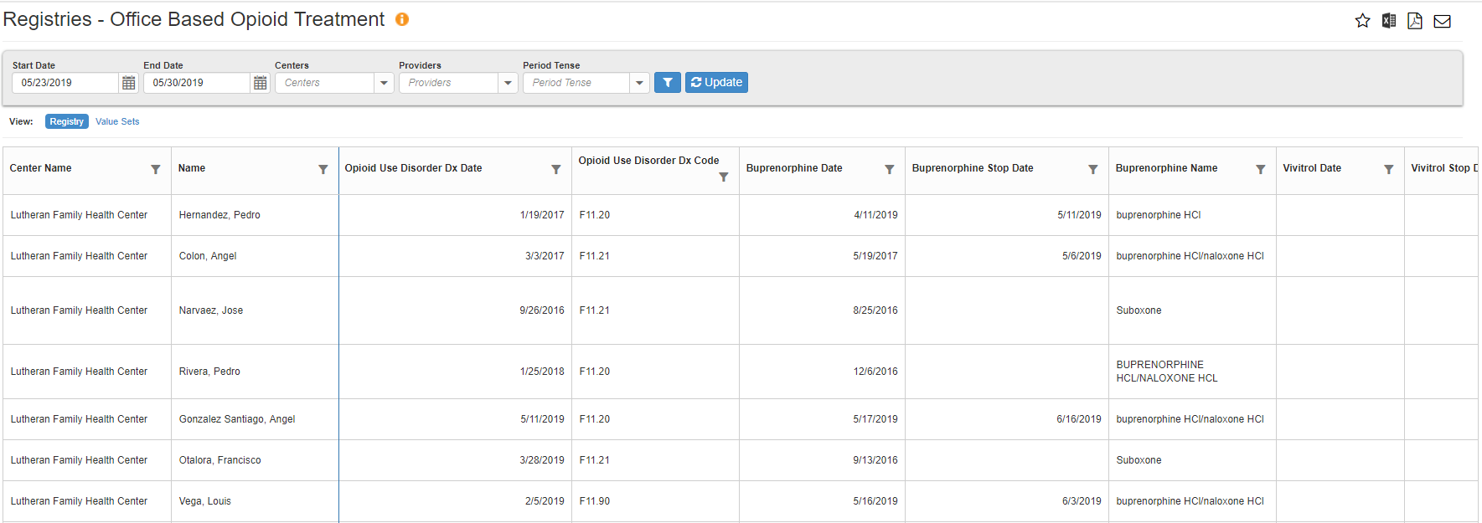
Office Based Opioid Treatment
OBOT Registry provides a method to monitor patients in a MAT program using Buprenorphine, Naltrexone, or other opioid use treatment medications
Notes:
Locum providers, urgent care
Understanding how the data is used.

Slide 24
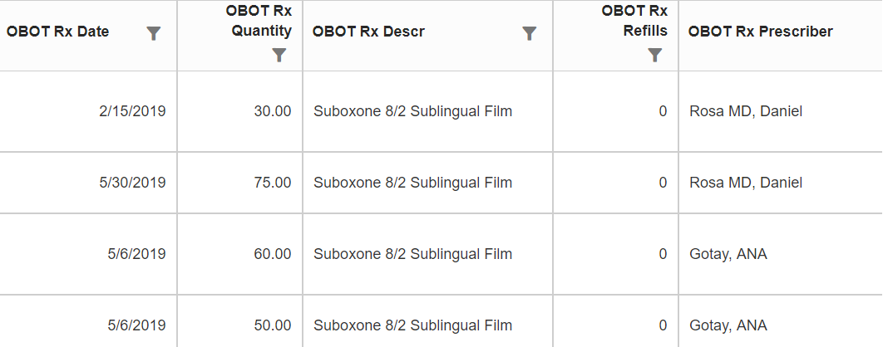
Office Based Opioid Treatment
OBOT Prescription Data
Notes:
Locum providers, urgent care
Understanding how the data is used.

Slide 25
Data Element Overview
Standard Demographics + SDOH Triggers
Visit information
  Next visit, last primary care, BHS, OBOT visit(s), date, rendering provider, location, and visit type
  ED visits
  Pain clinic visit date
  Referral to Behavioral Health
Medication (Prescription data in progress)
  Start/end date for ETOH misuse, OBOT (opioid misuse), active benzo, gabapentin, methadone
  Narcan (Med and date last prescribed)
  Narcan last used
  Prescription Drug Monitoring Program (PDMP)
Labs
  Urine tox screen results
  Buprenorphine Lab - (Urine/oral swab –y/n or level)
  Medication Assisted Therapy (MAT) screen
Assessments
  OBOT Assessment and date
  Treatment start date (here or elsewhere)
  Tobacco use
  Anxiety – GAD
  Depression – PHQ 2 and 9
  ETOH Assessment/date
  Drug Use Assessment
  Screener and Opioid Assessment for Patients with Pain Revised (SOAAP-R)
  Clinical Opioid Withdrawal Scale (COWS)
  Current Opioid Misuse (COMM)
  Opioid Risk Tool (ORT)
  Screen for Adult Anxiety Related Disorder (SCARRED)
  Drug Use Status
  Pill count (? adherence)
  Overdose date
CTRL Substance Use agreement and consent for treatment
OBOT program status, start date, update date

Slide 26
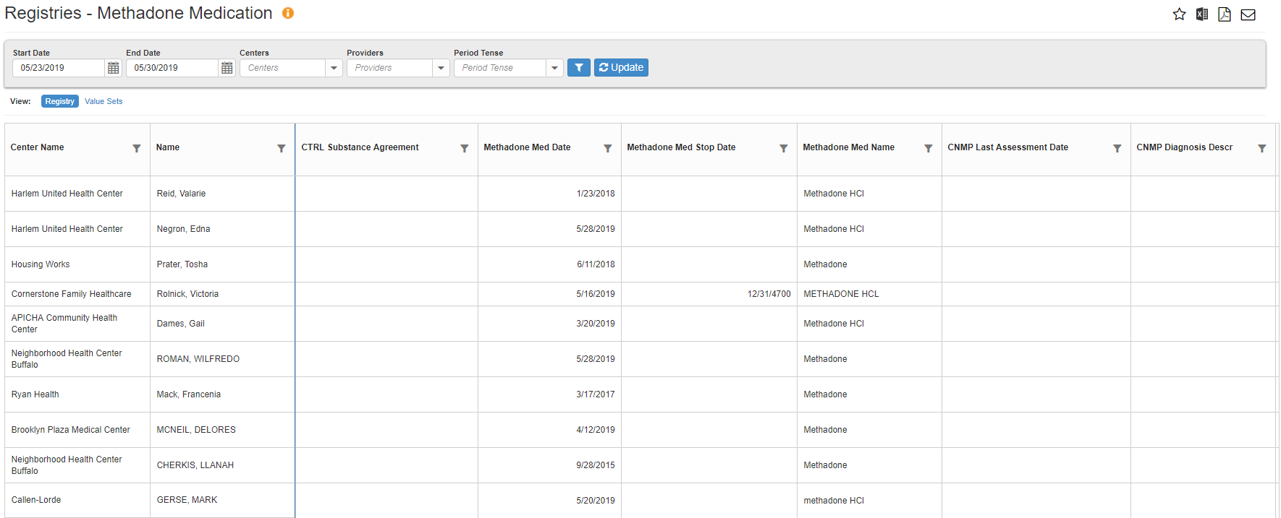
Methadone Medication
Track your patients with an active methadone prescription in the last 12 months.
Notes:
Locum providers, urgent care
Understanding how the data is used.

Slide 27
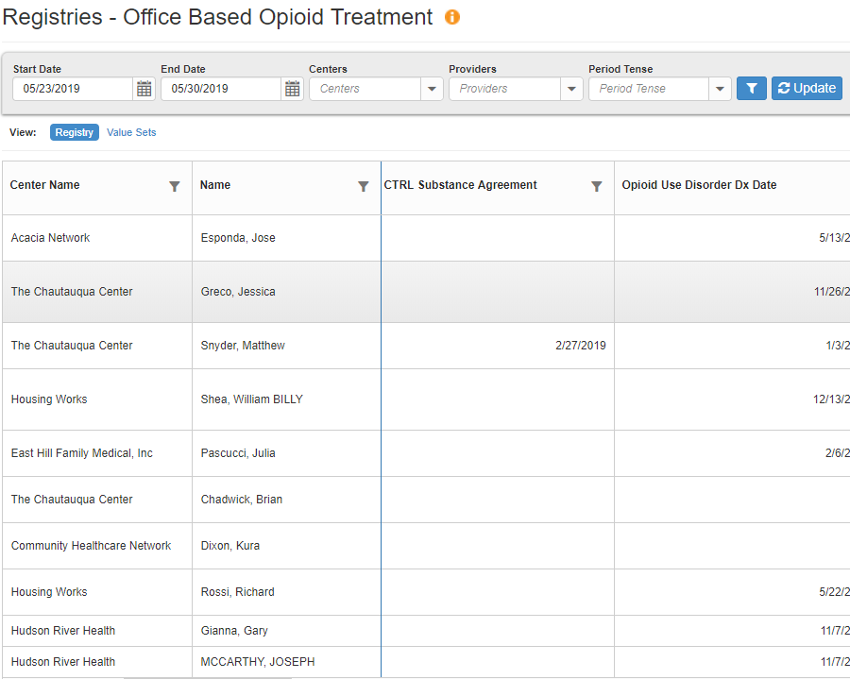
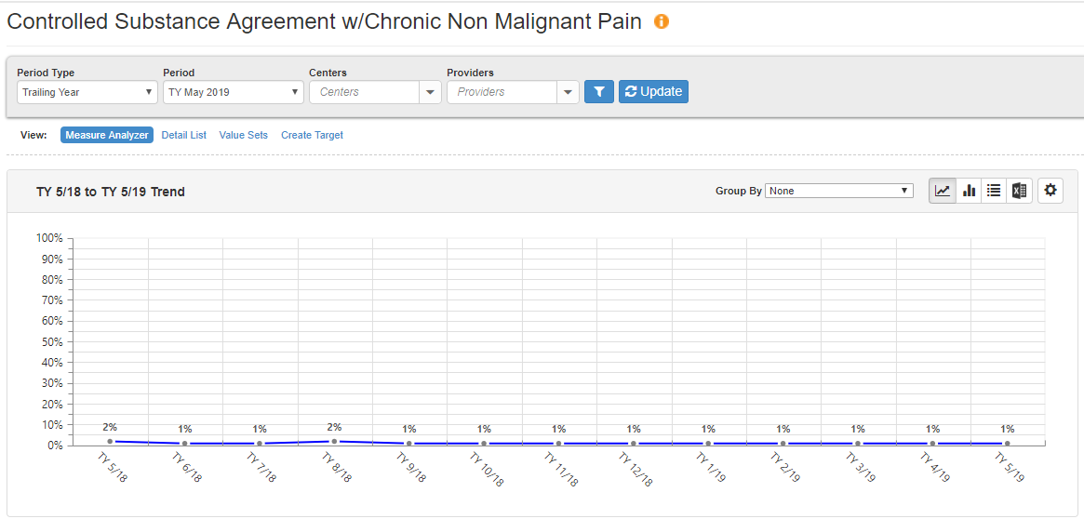
Controlled Substance Agreement
Monitor how many patients have a controlled substance agreement signed in the previous 12 months.
Also available on registry
Notes:
one big registry or smaller more specific registry - STI/Infect dx vs BH screening and f/u; safety - drug screen and controlled substance agreement

Slide 28
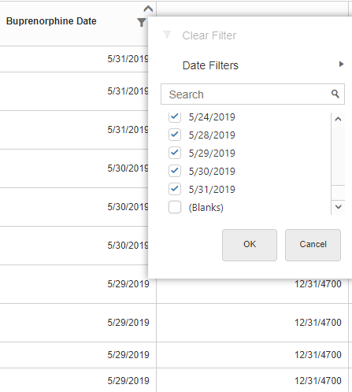

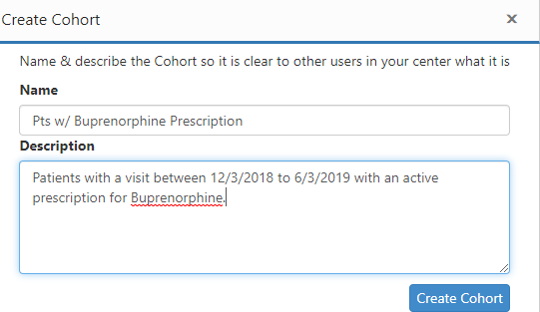
Cohorts | Active Buprenorphine Prescription
Patients with a buprenorphine prescription
  Office Based Opioid Treatment Registry
  Set date filter to 6 months
  Filter out blanks from Buprenorphine date column

Slide 29
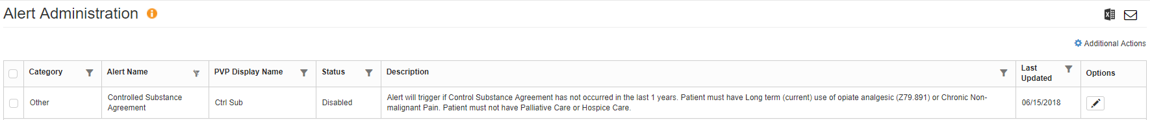
Point of Care Tools
Alerts for Controlled Substance Agreement and Screenings
Diagnoses and Risk Factors on Patient Visit Planning Report
  Diagnosis
    Chronic Non Malignant Pain
    HIV
  Risk Factors
    HDU (Hard Drug User/Illicit Drug Use Disorder)
    SUD (Substance Use Disorder)
    COT (Chronic Opioid Therapy)
    SMI

Slide 30
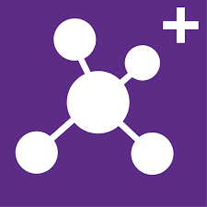
Tracking Care
Clinical Care
  HIV
  HEP C
  STI
Encounter Registry
  BH appt
  Pregnancy
  HIV Hep C
  Dental
Referrals and No Shows
Special Populations
  OB and OUD
  Dental and OUD
Cohorts

Slide 31
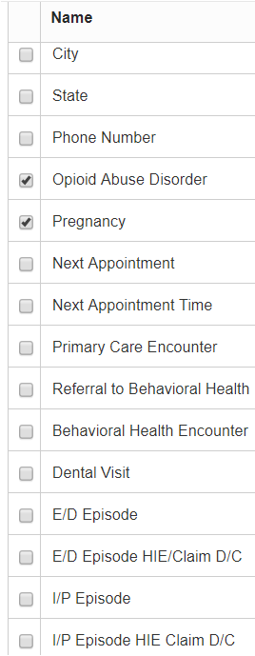
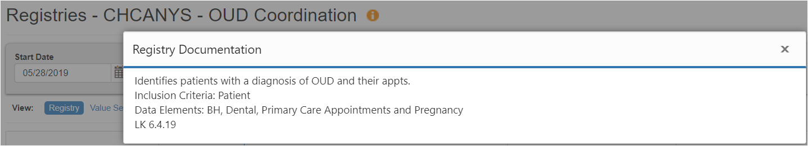
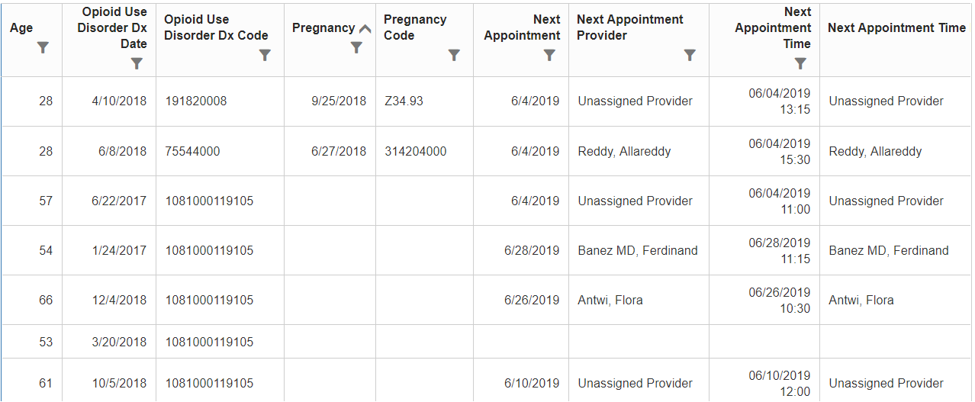
Custom Registry for OUD Coordination

Slide 32


Cohorts | Application
Use cohorts to filter measures and registries to defined patient populations
Use cohorts
  For tracking
  For improvement
  Program management

Slide 33
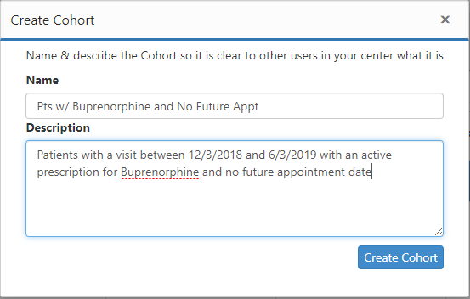
Cohorts | Patients Requiring Follow Up
Patients potentially falling out of touch
  Office Based Opioid Treatment Registry
  Set date filter to 6 months
  Active Buprenorphine treatment
  No Next Appointment or Stop Date

Slide 34
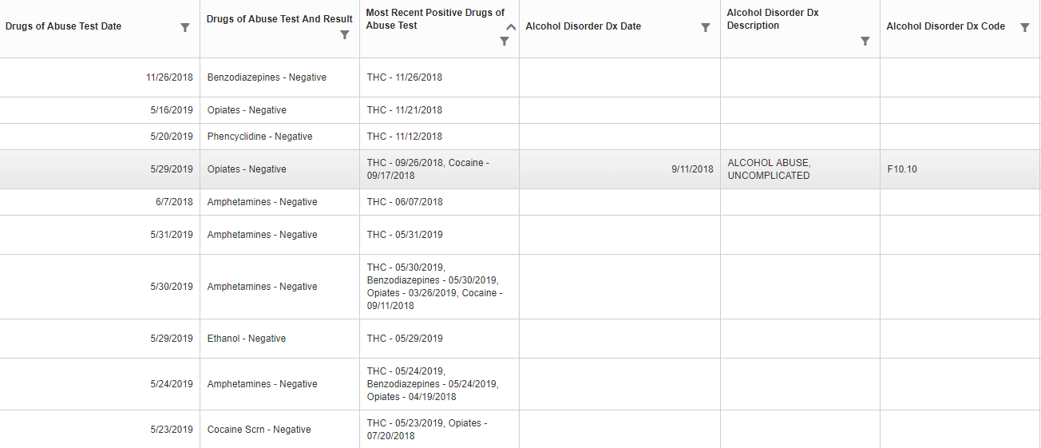
Cohorts | At Risk Patients
Patients with multiple risk factors for opioid abuse
  Opioid Medication – Potential Misuse Registry
  Set date filter to 6 months
  Filter to patients with a positive drug abuse or alcohol assessment result
  Filter to patients with a positive PHQ-2 or PHQ-9 score

Slide 35
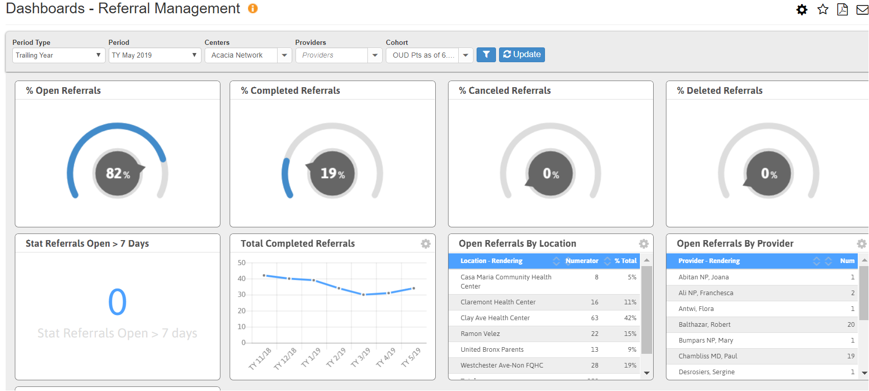
OUD Patients with Referrals

Slide 36
Performance Improvement Reporting
How are you doing?

Slide 37
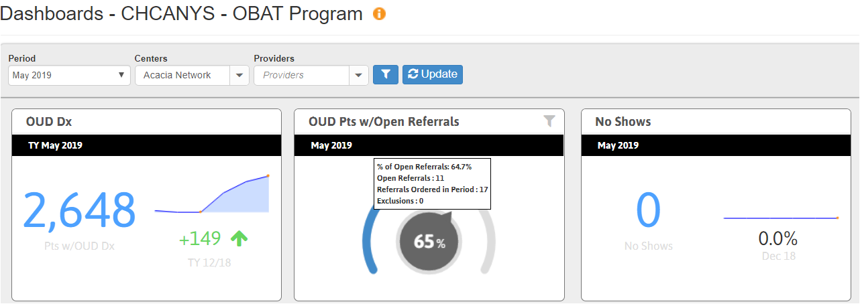

Slide 38
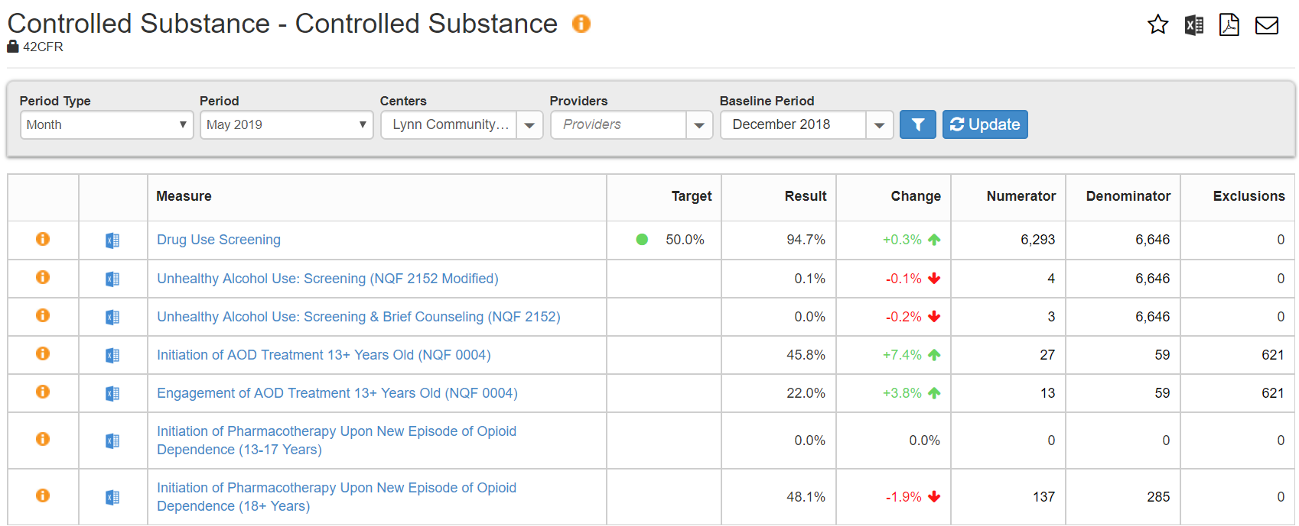
Controlled Substance Report

Slide 39
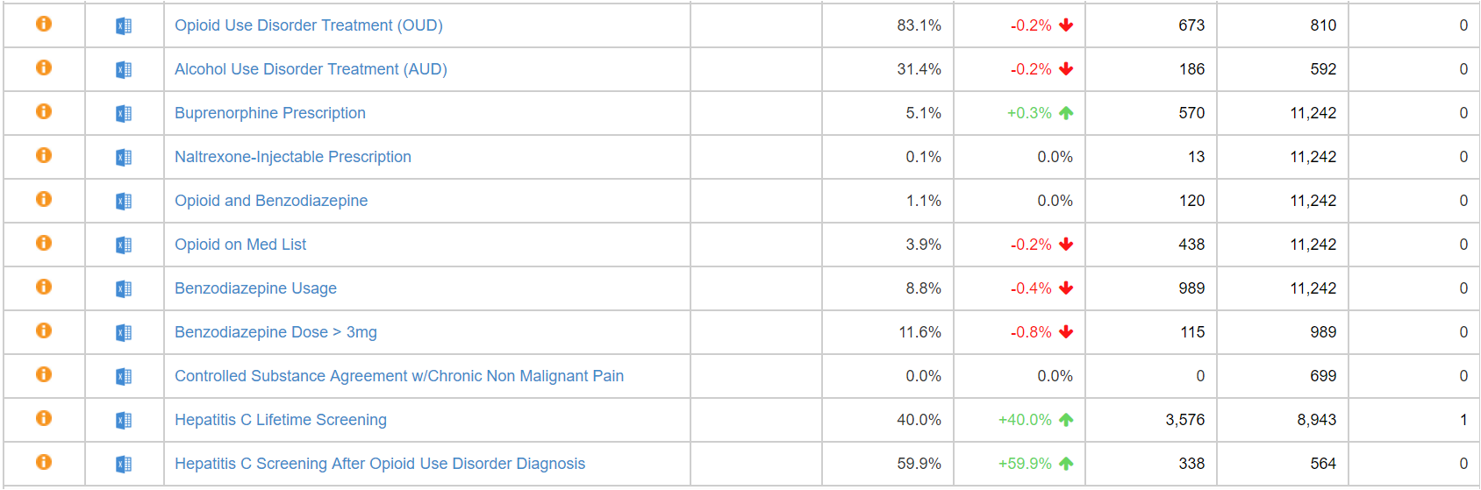
Controlled Substance (continued)

Slide 40
What’s on the Horizon for Substance Use
New Measures
  Naloxone Prescription with Opioid Use Disorder
  Continuity of Pharmacotherapy for Opioid Use Disorder (NQF 3175)
  Medication-Assisted Therapy prescribed for OUD by Provider Report
  Naloxone Prescription with Chronic Opioid Therapy
  Controlled Substance Agreement with Chronic Opioid Therapy
Prescription Data
  Added to OBOT registry and soon for Misuse Registry
  Capture last PDMP date
Notes:
Measure Description: Percentage of adults 18-64 years of age with pharmacotherapy for opioid use disorder (OUD) who have at least 180 days of continuous treatment

Slide 41
Questions?
?
?
?

Slide 42
Measures – Substance Disorder and Rx (5)
Alcohol Use Disorder Treatment (AUD)
Patients with an active medication for alcohol use disorder (AUD) during the reporting period.
Opioid Use Disorder Treatment (OUD)
Patients with an active medication for opioid use disorder (OUD) during the reporting period.
Buprenorphine
Prescription
Patients with at least one active Buprenorphine medication during the reporting period.
Naltrexone-Injectable
Prescription
Patients with at least one
active Naltrexone-Injectable medication provided during
the reporting period.
Controlled Substance
Agreement (CNMP)*
Patients with CNMP who have signed a controlled substance agreement in the last 12 months.
Notes:
Release 23.0 New Pharmacotherapy Measure for CHCANYS (2)
Initiation of Pharmacotherapy Upon New Episode of Opioid Dependence (18+ Years and 13-17 years)

Slide 43
Measures – Medication Management (4)
Opioid on Med List
Benzodiazepine Usage
  Patients with an active opioid medication on medication list during the reporting period.
  Patients with an active benzodiazepine during the reporting period.
Benzodiazepine Dose >3mg
Opioid and Benzodiazepine
  Patients on a benzodiazepine dose > 3mg
  Patients with both an active Opioid and an active Benzodiazepine at the same time during the reporting period.

Slide 44
Initiation and Engagement in Treatment (6)
Initiation of AOD Treatment
13+ Years Old* (NQF 0004)
Engagement of AOD Treatment
13+ Years Old* (NQF 0004)
  Patients with a new episode of alcohol and other drug (AOD) dependence who initiated treatment within 14 days of the diagnosis.
  Patients with a new episode of alcohol and other drug (AOD) dependence who initiated treatment and who had two or more additional services with an AOD diagnosis within 30 days of the initiation visit.
Initiation of Pharmacotherapy Upon New Episode of Opioid Dependence (13-17 and 18+ Years)
  Patients who initiate pharmacotherapy with at least 1 prescription for opioid treatment medication within 30 days following a diagnosis of opioid dependence (OUD).
* Filters can be used to see results for different age ranges.

Slide 45
Prevention/Screening (5)
Unhealthy Alcohol Use: Screening & Brief Counseling (NQF 2152)
Unhealthy Alcohol Use: Screening
(NQF 2152 Modified)
Drug Use Component (nonmedical prescription drug use and illicit drug use)
  Patients aged 18 years and older who were screened for unhealthy alcohol use, at least once within the last 24 months AND received brief counseling if identified as an unhealthy alcohol user.
  Patients aged 18 years and older who were screened for unhealthy alcohol use using a systematic screening method at least once in the last 24 months.
  Patients who were screened for nonmedical prescription drug use and illicit drug use at least once within the last 24 months using a systematic screening method.
Hepatitis C Lifetime Screening
Hepatitis C Screening After Opioid Use Disorder Diagnosis
  Patients aged 12+ who had at least one Hepatitis C screening in their lifetime.
  Patients aged 12+ who had at least one Hepatitis C screening on or after an Opioid Use Disorder (OUD) Dx.

Slide 46
Policies and Procedures
Create list of roles and responsibilities for members of care team
How are you tracking referrals and coordination with other services needed, i.e. food banks, support groups, behavioral health services

Slide 47
Steps
Identify patients with CNMP diagnosis using the Pain Management Registry
Filter to see all patients who have an active opioid prescription and those with no stop date
Use registry to identify other diagnoses and conditions including SUD/OUD, AUD, other drug abuse, etc
Enrollment in other programs: OBOT and Methadone Medication Registries

