Slide 1

NY State of Health Updates and Enrollment Trends
June 2, 2025

Slide 2
Today’s Agenda
Background
NY State of Health Programs
Cost-Sharing Reductions
Enrollment Snapshot
Enrollment Process
Community Engagement

Slide 3
Background

Slide 4

Background: Affordable Care Act
Federal requirement for states to have a health insurance exchange.
NYS chose to create and run their own health insurance exchange.
The New York State of Health, Health Plan Market Place opened in 2013.
The Marketplace helps New Yorkers access affordable, high quality health insurance.

Slide 5
Background: Programs
Medicaid | Child Health Plus (CHIP) | The Essential Plan (EP) | Qualified Health Plans (QHPs)
Low –income residents who are: Pregnant women and infants; Children ages 1-18; Parents and caretaker relatives of dependent children; or Adults aged 19-64, who are not pregnant and not eligible for Medicare | For children under 19 years of age who are not eligible for Medicaid. Not covered by other health insurance No requirement for legal residency. $0 to low- cost premiums | For people with lower incomes who don’t qualify for Medicaid or Child Health Plus. Lawfully present in the U.S. 19-64 years old $0 premium | For people whose income is 250% Federal Poverty Level (FPL) and above. Lawfully present in the U.S. They are not eligible for Medicaid and the Essential Plan. They may be eligible for government subsidies.

Slide 6

Background: Preventive Services
Health plans offered on the Marketplace cover many free, preventive services, including:
  Regular wellness checkups
  Vaccinations (including flu)
  Screenings:
    Cancer (including mammograms
    and colonoscopies)
    Depression
    Diabetes
    High blood pressure

Slide 7

Background: Essential Health Benefits
Health plans offered on the Marketplace also cover other essential services, such as:
  Prenatal and newborn care
  Hospital stays and emergency services
  Prescription drugs
  Mental health counseling
  Substance use and addiction counseling
  Smoking cessation programs (NYC Quits)
  And more!

Slide 8
Background: Income Eligibility
Annual Income for 1 Adult | Annual Income for Household of 4 | Monthly Premium
$21,597 | $44,367 | Eligible for Medicaid: $0
$23,475 | $48,225 | Eligible for Essential Plan: $0
$31,300 | $64,300 | Eligible for Essential Plan: $0
$39,125 | $80,375 | Eligible for Expanded Essential Plan: $0
Most eligible above $31,300 | Most eligible above $64,300 | Eligible for Tax Credits

Slide 9
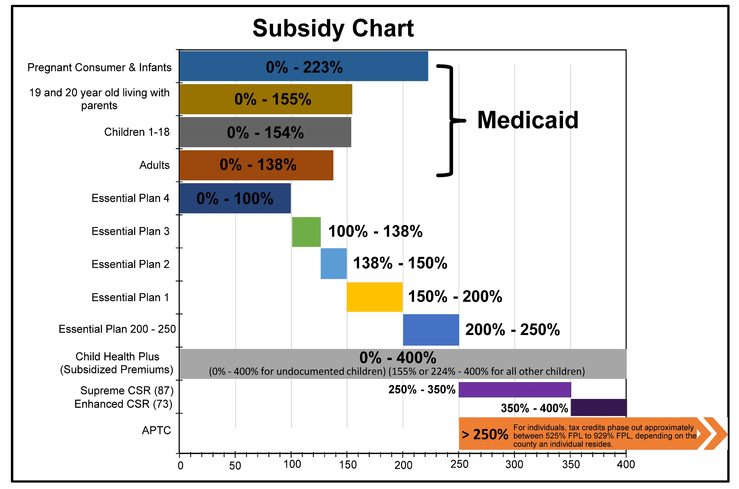
Program Eligibility
Programs: Program Eligibility

Slide 10

2025: QHP Insurers Individual Market
Note: When counting - Highmark of Western NY/Highmark of Northeastern NY, Anthem BlueCross/BlueCross BlueShield, and Excellus/Univera are each counted as one.
Notes:
Empire BC/BCBS is changing their name to Anthem BC BCBS for 2025.

Slide 11

2025: Essential Plan Insurers
Note: When counting, Excellus/Univera is counted as one. Affinity by Molina Healthcare and Molina Healthcare are also counted as one.

Slide 12
Cost Sharing Reductions
Notes:
•In March of 2024, NY State of Health applied for an amendment of the 1332 Innovation Waiver that would further improve access to healthcare for New Yorkers.
•The goal of the waiver amendment is to improve overall healthcare for New Yorkers by extending cost sharing subsidies and reducing deductibles, copayments, and other cost-sharing for low- and moderate-income New Yorkers, individuals with Diabetes, and those who are pregnant or postpartum.

Slide 13
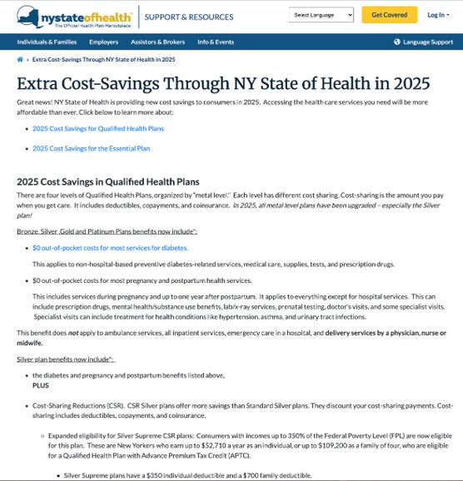
Cost-Sharing Reductions: New For 2025
In January 2025, NY State of Health implemented three (3) new Cost-Sharing Reduction (CSR) initiatives
Nearly 118,000 consumers are estimated to benefit from these cost sharing subsidies, resulting in an annual savings of $307 Million for consumers
in 2025 and $1.3 Billion from 2025 – 2028
Cost-Sharing is the amount you pay when you get care. It includes deductibles, copayments, and coinsurance.

Slide 14

Cost-Sharing Reductions: New For 2025
Incomes greater than 250% FPL up to 400% FPL
Diabetes
Non-hospital-based preventive diabetes-related services, medical care, supplies, tests, and prescription drugs.
Pregnancy and Postpartum Care
  Includes services during pregnancy and up to one year after postpartum
  Applies to everything except for hospital services
  Does not apply to ambulance services, all inpatient services, emergency care in a hospital, and delivery services by a physician, nurse or midwife.

Slide 15
Cost-Sharing Reductions: 250% FPL up to 400% FPL
Qualified Health Plans are organized by metal level (Gold, Silver, Bronze), each with different cost-sharing
  CSR Silver plans offer more savings than Standard Silver plans.
  Silver CSR 87: incomes up to $52,710 for an individual, $109,200 Household of four
  Silver CSR 73: incomes up to $60,240 for an individual, $124,800 Household of four
May be eligible for a Qualified Health Plan with Advance Premium Tax Credit (APTC)
Cost Sharing for Health Care Services | Silver Supreme | Silver Enhanced
Annual Deductible | $350 | $1,855
Preventive Care | Free | Free
Primary Care Physician Visit* | $15 | $30
Specialist Visit* | $35 | $65
Inpatient Hospital Stay per admission | $250 | $1,500
Behavioral Health Outpatient Visit* | $15 | $30
Behavioral Health Inpatient Visit per admission | $250 | $1,500
Emergency Room | $75 | $275
Urgent Care | $50 | $70
Physical Therapy, Speech Therapy, Occupational Therapy | $25 | $30

Slide 16
Cost-Sharing Reductions: Diabetes
This initiative aims to reduce consumer' out-of-pocket costs and is expected to improve consumers' ability to manage their diabetes by:
  Improving access to recommended care;
  Lowering the likelihood of unnecessary hospitalizations; and
  Improving overall health.
NY State of Health is pursuing this plan design, in order to address health inequities by focusing on conditions (such as diabetes) that disproportionately impact lower-income communities, including communities of color.

Slide 17
Cost-Sharing Reductions: Diabetes
NY State of Health consumers who have a primary diagnosis of diabetes, and who are enrolled in Essential Plan or in a metal level Qualified Health Plan (QHP) [Bronze, Gold, Silver, or Platinum Plan] will have in-network cost-sharing eliminated for the following services related to diabetes care:
  Medical Care such as non-hospital-based preventive diabetes-related services.
  Prescription Drugs including Insulin.
  Supplies.
  Diagnostics.
Consumers will not be charged co-pays, deductibles, or coinsurance for these services.
Cost-sharing will remain in place for hospitalization and related costs and most specialist office visits.
Excludes Catastrophic QHPs.

Slide 18
Cost-Sharing Reductions: Pregnancy and Postpartum Care
NY State of Health consumers who are pregnant or postpartum and who are in a metal-level Qualified Health Plan (QHP) [Bronze, Gold, Silver, or Platinum] will have in-network cost sharing eliminated for most services except labor and delivery.
Some examples include:
  - Office visits - Prenatal testing
  - Prenatal vitamins - Breast pumps and supplies
  - Prescription drugs - Blood pressure monitors
  - Lab x-ray services and supplies - Outpatient services
  - Mental health/substance use benefits - Some specialist visits

Slide 19
Cost-Sharing Reductions: Pregnancy and Postpartum Care
Cost-sharing will still apply to physician, nurse practitioner and midwife services for delivery as well as, inpatient hospital and birthing center services for delivery.
Cost-Sharing will apply to the services below.
  Ambulance Services
  All Inpatient Services (hospital, rehabilitation, metal health/substance use disorder, hospice)
  Emergency Care in a Hospital
  Physician, Nurse Practitioner and Midwife services for Delivery
  Inpatient Hospital and Birthing Center services for Delivery
  Pediatric Vision and Dental
  Out-of-pocket costs for labor and delivery are not included in this initiative.
Excludes Catastrophic Plans.
High-Deductible Health Plans are subject to specific rules.

Slide 20
Cost-Sharing Reductions: CSRs Information Page
For more information visit
https://info.nystateofhealth.ny.gov/extra-cost-savings-through-ny-state-health-2025

Slide 21
Enrollment Snapshot

Slide 22
Enrollment Snapshot: Overview
As of September 2024
Program | Enrollment
Child Health Plus | 590,648
Medicaid | 4,371,059
Essential Plan | 1,533,653
Qualified Health Plan | 226,505
TOTAL | 6,721,865

Slide 23
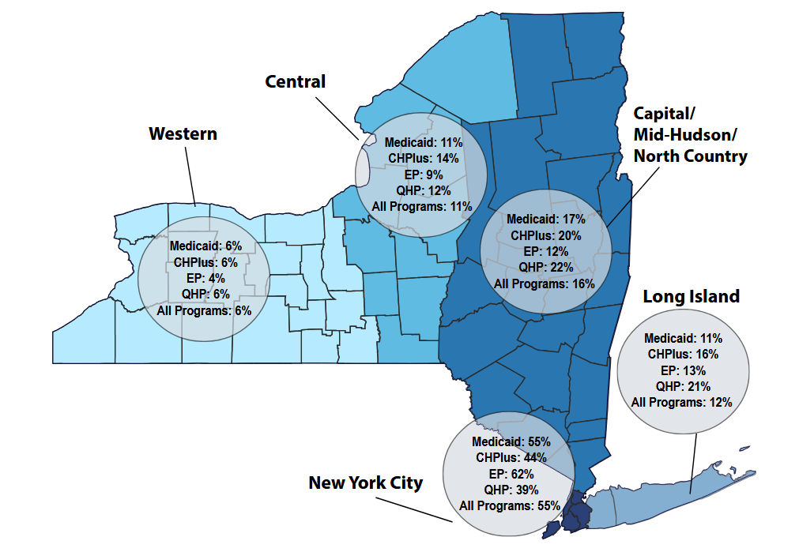
Enrollment Snapshot: Region
Slightly more than half (55%) of Marketplace enrollees live in NYC.
12% live in Long Island
16% live in the Capitol, Mid Hudson, North Country region
6% live in the Western region
11% live in the Central region
Enrollment by region largely track to each region’s respective share of the States’ non- elderly population.

Slide 24
Enrollment Snapshot: Preferred Written Language by Program
Overall, 27% of Marketplace enrollees indicated a preferred written language other than English.
Over 74,000 enrollees reported one of 23 different preferred languages
Language | Medicaid | CHPlus | EP | QHP | All Programs
Chinese | 3% | 2% | 5% | 2% | 3%
English | 73% | 71% | 72% | 95% | 73%
Russian | 1% | 1% | 2% | <1% | 1%
Spanish | 22% | 25% | 19% | 3% | 21%

Slide 25
Enrollment Snapshot: Race and Ethnicity
Race | Medicaid | CHPlus | EP | QHP | All Programs
White, Non-Hispanic | 32% | 40% | 28% | 66% | 33%
Black/African American | 15% | 12% | 14% | 7% | 14%
Asian/Pacific Islander | 13% | 11% | 22% | 12% | 15%
Other | 15% | 16% | 15% | 6% | 15%
Did Not Report | 29% | 24% | 23% | 12% | 27%
Ethnicity | Medicaid | CHPlus | EP | QHP | All Programs
Hispanic | 29% | 31% | 27% | 10% | 28%
Non-Hispanic | 56% | 58% | 63% | 83% | 59%
Did Not Provide | 15% | 11% | 10% | 7% | 13%

Slide 26
Enrollment Snapshot: Age by Program
Age Group | Medicaid | CHPlus | EP | QHP | All Programs
< 18 Years | 33% | 96% | - | 4% | 30%
18 – 25 Years | 14% | 4% | 17% | 8% | 13%
26 – 34 Years | 16% | - | 24% | 18% | 16%
35 – 44 Years | 15% | - | 23% | 18% | 15%
45 – 54 Years | 11% | - | 20% | 20% | 12%
55 – 64 Years | 10% | - | 16% | 31% | 11%
65+ Years | 2% | - | - | 2% | 2%

Slide 27
Enrollment Snapshot: QHP Trends

Slide 28
Enrollment Snapshot: 2024 Report
More information available in the 2024 Enrollment Report:
https://info.nystateofhealth.ny.gov/sites/default/files/EnrollmentReport2024a.pdf

Slide 29
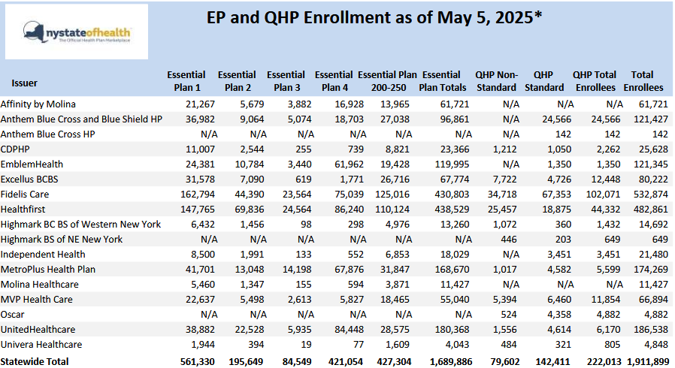
Enrollment Snapshot: EP and QHP Enrollment by County
Essential Plan and QHP Enrollment by County and Plan available at:
https://info.nystateofhealth.ny.gov/enrollmentdata

Slide 30
Enrollment Process

Slide 31

Enrollment Process: Role of The Assistor
An Assistor is an individual who is certified to provide consumers with enrollment assistance on the Marketplace.
NY State of Health has over 5,000 Assistors from over 320 agencies across the State.
Assistors are required to complete the NY State of Health certified assistor course and exam, as well as attend annual trainings.

Slide 32
Enrollment Process: Role of The Assistor
NY State of Health offers free personalized help determine the plan and financial assistance eligibility that is best for you
Thousands of certified enrollment assistors available to help you in your preferred language and in a community near you
No one should ever pay for enrollment assistance
You can find assistance by:
  Going to: http://info.nystateofhealth.ny.gov/findassistor
  Calling the NY State of Health Customer Service Center at
  1-855-355-5777
  Visiting NYStateOfHealth.ny.gov
    You can use the chat feature on the website to help complete your application, available during customer service center hour

Slide 33
Enrollment Process: Overview
Enrollment Assistors
Located in every county
Customer Service Center
1-855-355-5777
Get answers to your questions
Website
nystateofhealth.ny.gov
Complete application online
Make appointment for free one-on-one application assistance
Assistance in 39 languages
Complete application over the phone
Open Mon-Fri 8am to 8pm & Sat 9am to 1pm
Assistance in all languages
Request assistance from Customer Service Center or in-person assistor if needed
http://info.nystateofhealth.ny.gov/IPANavigatorSiteLocations

Slide 34
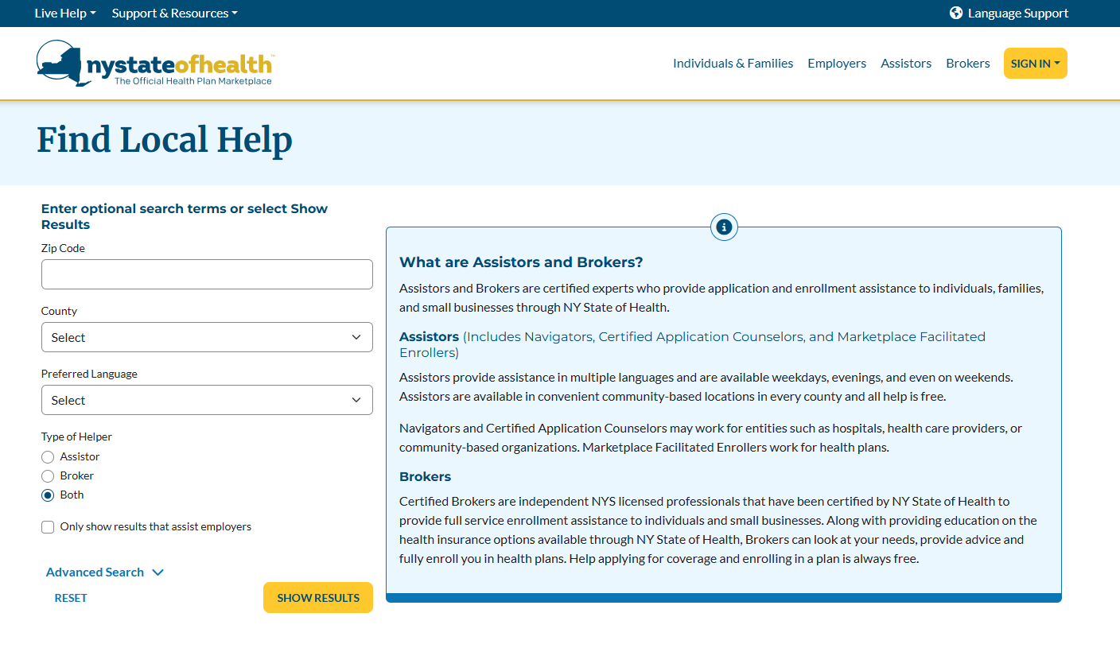
Enrollment Process: Assistors & Brokers
This tool provides a way to find a certified assistor in your area. Assistors are available in every county in NYS.
Tool can be found here: https://nystateofhealth.ny.gov/agent/hx_brokerSearch?fromPage=INDIVIDUAL
NYSOH has over 5,000 Assistors from over 320 agencies
And over 2600 Certified and Licensed Brokers from over 420 agencies.

Slide 35
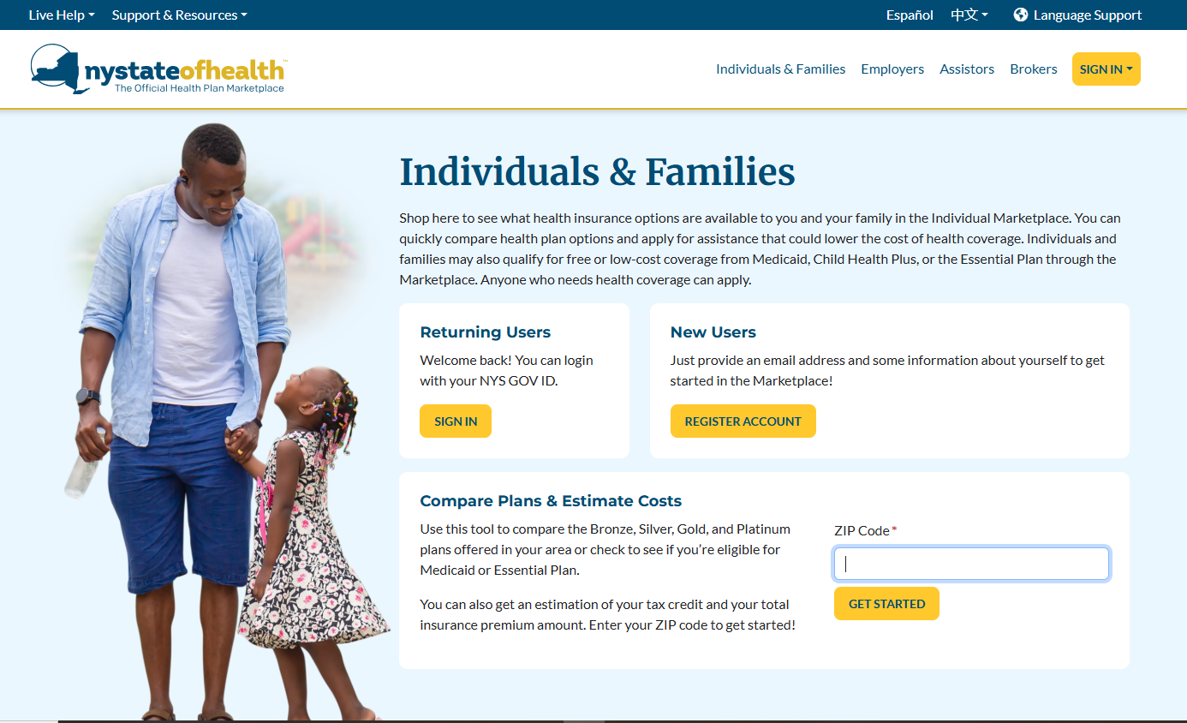
Enrollment Process: Estimating Financial Assistance
Use the Anonymous Plan Search tool to determine the consumer’s estimated premium after tax credits.
https://nystateofhealth.ny.gov/individual

Slide 36
Community Engagement

Slide 37


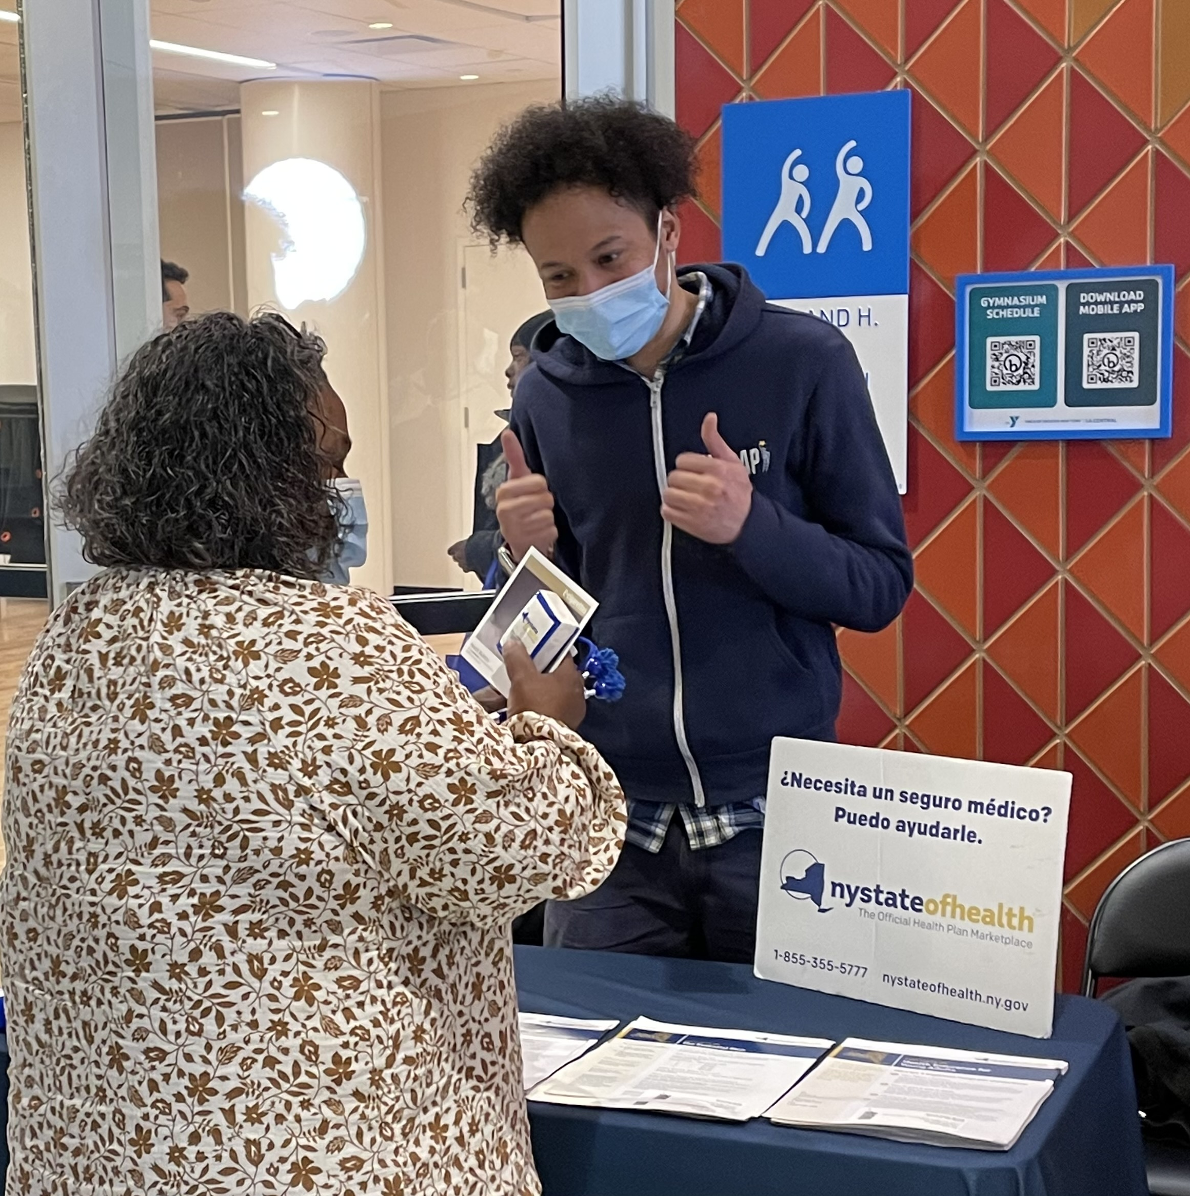


Community Engagement: Partnerships
NY State of Health informational table setup/staffed at your community events,
NY State of Health promotional information included in your organization’s newsletter, informational monitors, social media platforms, and other co-branded materials
Lunch and Learn presentations on NY State of Health in real time and/or virtually
Let’s share ideas for unique partnership/community experiences!
Notes:
Through our partnerships, we….

Slide 38
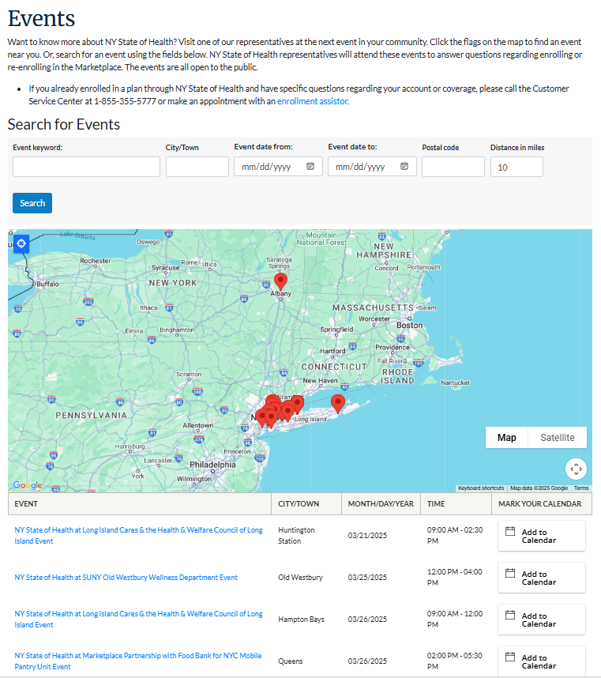
Community Engagement: Events
Events calendar located on the NY State of Health Informational Site
Searchable database of all events statewide
“Add to Calendar” feature to provide reminders on your desktop or device
Events occur throughout the year
Notes:
To learn more about the NY State of Health – visit our website at: NYStateohealth.ny.gov or call: 1.855.355.5777

Slide 39
Thank You

