Slide 1
CHCANYS NYS-HCCN presents a four-part learning series with Online Business Systems Cybersecurity Revitalized: Adapting to a Changing Cybersecurity Landscape
What’s in Store for 2024?
Session 1
January 9, 2024

Slide 2
New York State HCCN Objectives
Project Period 2022-2025
2022-2025 Project Period
1
Clinical Quality
Patient Engagement
Patient Privacy & Cybersecurity
Social Risk Factor Intervention
Disaggregated Patient-level Data (UDS+)
2
Interoperable Data Exchange & Integration
Patient-Centered Care
Data Utilization
Leveraging Digital Health Tools
Health IT Usability & Adoption
Health Equity and REaL Data Collection*
Improving Digital Health Tools- Closed Loop Referrals*
3
Provider and Staff Wellbeing
* - Applicant Choice Objective
Bold- Objective Carried over into 2022-2025
Notes:
=========================

Slide 3
What’s in Store for 2024?
Adam Kehler, CISSP
Director of RSP Healthcare Service
Shelby Kobes, CCSFP
Principal Healthcare Consultant: Risk, Security & Privacy
Jordan Wiseman, MLS, CISSP, QSA
Fellow; Risk, Security & Privacy Team

Slide 4
2024 Updates and
Current Security Threats
Notes:
https://www.freepik.com/free-photo/three-businesspeople-looking-at-business-report-in-the-office_3105852.htm#term=blue%20business&page=1&position=19

Slide 5
Agenda
Introduction
2023 In Review
2024 Legislation
Current Threats
Third Party Risk
Cyber Insurance
405(d) Updates
AI Security

Slide 6
2023 In Review
Notes:
http://pixabay.com/en/keyboard-computer-internet-work-561016/

Slide 7
OCR Enforcement Summary
Date | Entity | Category
Jan 3 | Life Hope Labs | Right of Access
Feb 2 | Banner Health | Hacking
May 8 | David Mente, MA, LPC | Right of Access
May 16 | MedEvolve | Data Breach
June 5 | Manasa Health Center | Responding to Online Review
June 15 | Yakima Valley Memorial Hospital | Snooping
June 28 | iHealth Solutions | Business Associate Breach
Aug 24 | UHC | Right of Access
Sept 11 | Local Initiative Health Authority for Los Angeles County | Data Breach
Oct 31 | Doctors’ Management Services, Inc | Ransomware
Nov 20 | St. Joseph’s Medical Center | Disclosure to News Reporter
Nov 15 | Optum Medical Care | Right of Access
Notes:
Right of Access continues to be a focus
Data Breach only resulted in fines if an OCR investigation found negligence related to compliance. To avoid: Implement 405(d).

Slide 8
HIPAA/OCR Summary
April 12 – Expiration of Telehealth Enforcement Discretion
April 12 – NPRM on HIPAA and Reproductive Health
July 20 – HHOS/OCR & FTC Warn Hospital Systems about Online Tracking Tech

Slide 9
2024 Legislation
Notes:
http://pixabay.com/en/keyboard-computer-internet-work-561016/

Slide 10
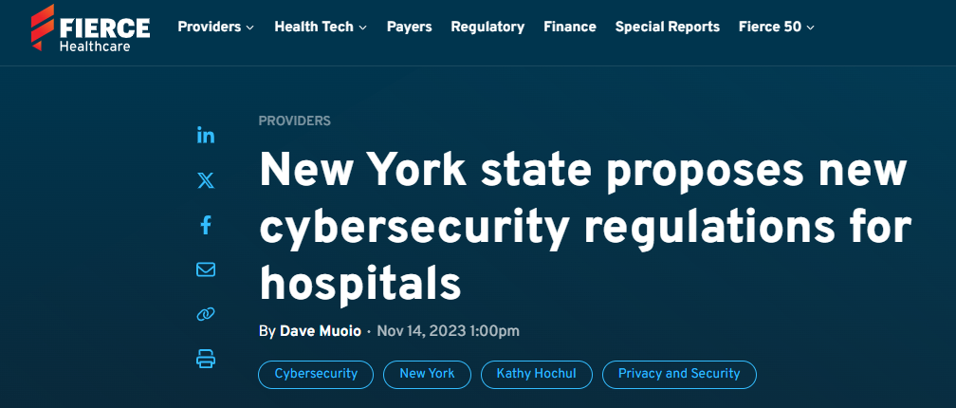

Slide 11
New York Cybersecurity for Hospitals Proposed Rule
Currently applies only to hospitals
Acts as a supplement to HIPAA
$500 million in funding to help implement requirements
Requirements include:
Designation of a CISO (can be employee or virtual)
Written Policies and Procedures
Incident Response Plans and Reporting – 2 HOURS after discovery!
Vulnerability Testing and Penetration Testing
MFA for ALL remote access
Audit Logging – 6 year retention

Slide 12
HIPAA Privacy Rule Proposed Rule
Issued January 21, 2021
Expect Final Rule in 2024
Designed to increase care coordination and break down barriers to information sharing and interoperability
Addresses Right of Access, Information Sharing, Notice of Privacy Practices
Aims to reconcile HIPAA with 42 CFR Part 2 and CARES Act

Slide 13
Current Threats
Notes:
http://pixabay.com/en/keyboard-computer-internet-work-561016/

Slide 14
14

Slide 15
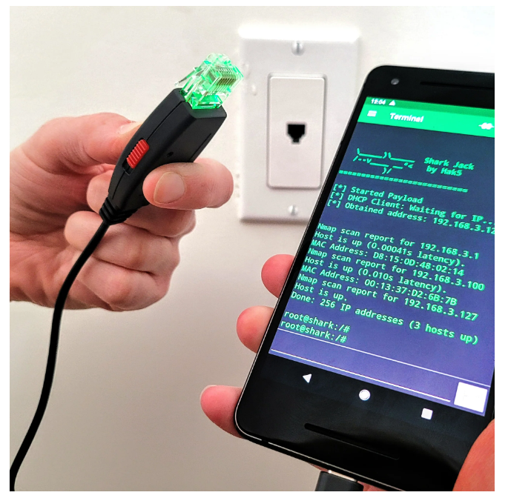
Shark Jack
Hotplug attack, meet LAN. These pocket-sized hacking tool boxes perform network assessments in seconds!
15

Slide 16
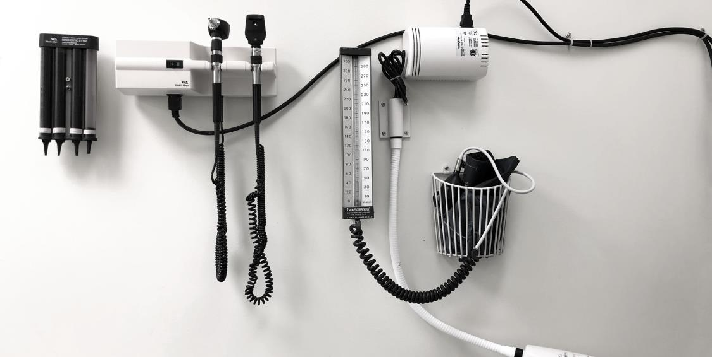
PCA Threat Results from 2020 and 2021 HIPAA SRAs
*Ransomware
90%
*Unauthorized Access
Data
70%
*Phishing
65%
*Unauthorized
Paper Disclosure
50%
*Theft of
Equipment
40%
65%
90%
70%
50%
40%
PCA Threat Results from 2020 and 2021 SRA
*Align with 405(d) HHS Managing Threats (HICP)

Slide 17
Hacking Tool Mitigations /
The top three priorities from the
01
Network Ports Need Security
Unpatched
Port security on switches
Device management
02
Protect Your Access
Secure Card Stock
Reduce Contractor Cards
Audit Card access systems
03
USB Should not be allowed
Limit access to USB device
No third-party fancy Keyboards
Notes:
Implementing #2 and #3 could have prevented OR detected this attack. You never want to hear about it from the FBI.
#2: The organization was already in the process of evaluating vendors
#3: This was already in the budget for the next cycle

Slide 18
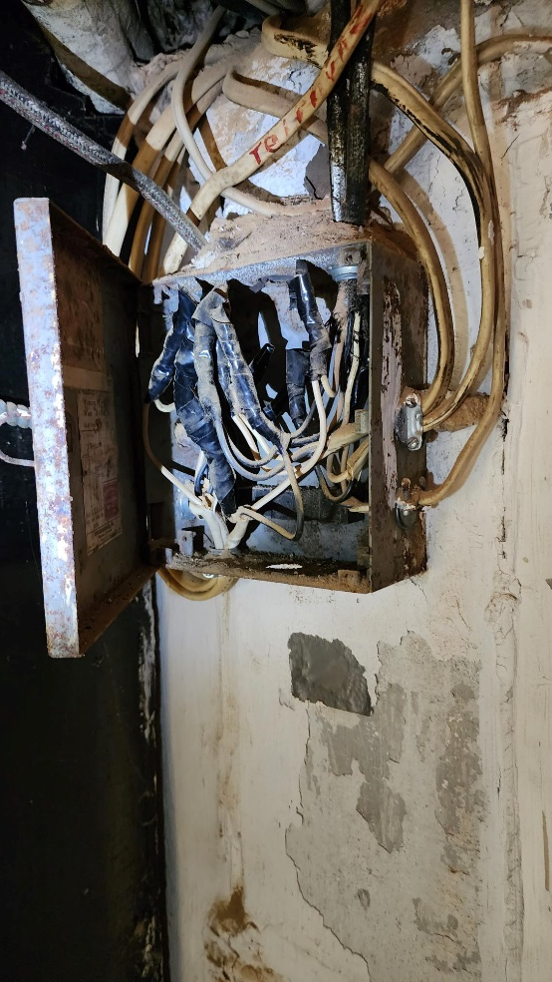
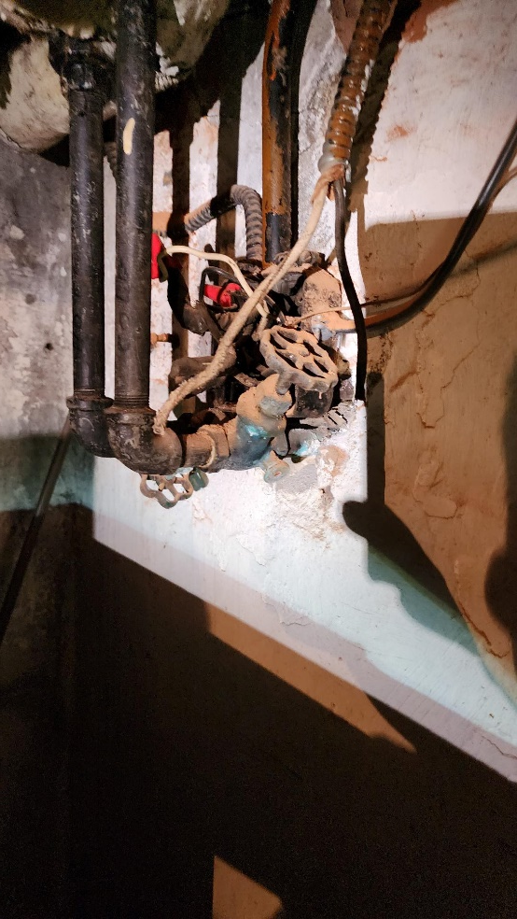
What Is The Risk
18

Slide 19
What Is The Risk
19

Slide 20
Third-Party Risk
Notes:
http://pixabay.com/en/keyboard-computer-internet-work-561016/

Slide 21
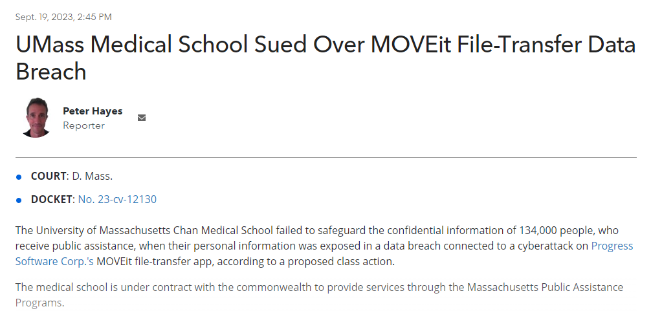
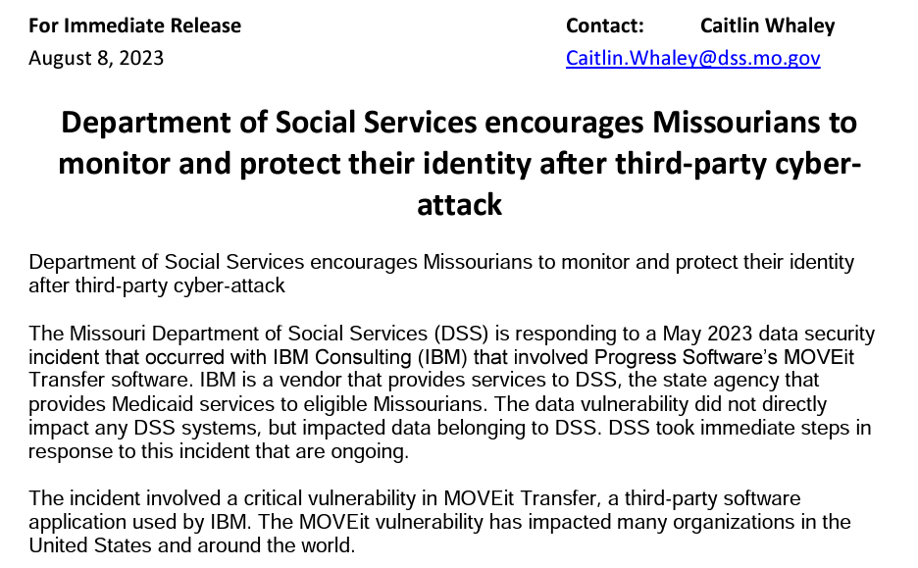
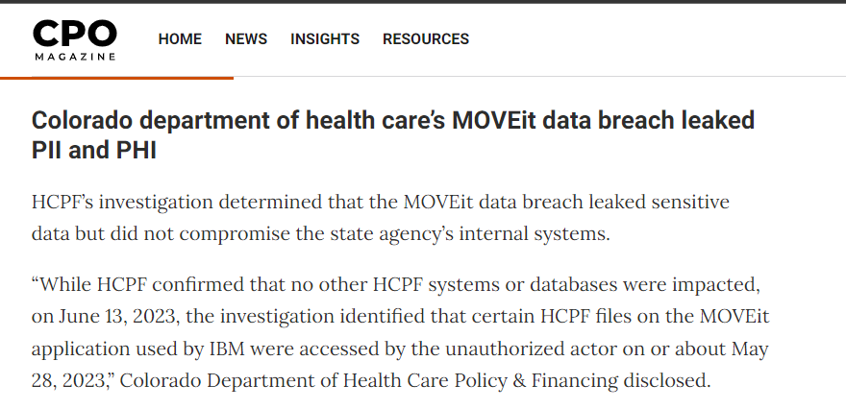

Slide 22
MoveIT Vulnerability
HC3 Guidance - https://www.hhs.gov/sites/default/files/critical-vulnerability-moveit-transfer-software-sector-alert.pdf
Disable all HTTP and HTTPs traffic to your MOVEit Transfer environment
Access via Remote Desktop and Localhost
Apply the Patch
Enable all HTTP and HTTPs traffic to your MOVEit Transfer environment
Bookmark the Progress Security Page - https://www.progress.com/security/moveit-transfer-and-moveit-cloud-vulnerability
Reinforces the importance of standard security practices including inventory of software assets and vendor management
Notes:
MOVEit is a file transfer program owned by Progress Software. A wide range of organizations in the public and private sector used the program to move sensitive personal data. That includes financial services companies, government agencies, pension funds and more. In May 2023, a hacker group called CL0P gained access to MOVEit. Since then, Reuters reports that the hack has impacted tens of millions of people.
"The MOVEit breach highlights a particular vulnerability, in which bad actors can obtain data from multiple companies all in one hack," says Michael Bruemmer, the Head of Global Data Breach Resolution at Experian. "The consumers are innocent parties to this type of breach, which only emphasizes the need for individuals to be vigilant with their own data."
MOVEit Transfer web apps were infiltrated by malware that was used to steal sensitive information from databases. CL0P has sent ransom notes to upper-level executives at companies that have been hacked. The group threatens to publish files to its website, which leaks private data to the public, if organizations don't pay up.

Slide 23
The Security Rule and Third Parties
Organizational Safeguards
45 C.F.R. § 164.314
Standard: Business associate contracts or other arrangements. The contract or other arrangement required by § 164.308(b)(3) must meet the requirements of paragraph (a)(2)(i), (a)(2)(ii), or (a)(2)(iii) of this section, as applicable.
Implementation specifications (Required) -
Business associate contracts. The contract must provide that the business associate will –
Comply with the applicable requirements of this subpart;
In accordance with § 164.308(b)(2), ensure that any subcontractors that create, receive, maintain, or transmit electronic protected health information on behalf of the business associate agree to comply with the applicable requirements of this subpart by entering into a contract or other arrangement that complies with this section; and
Report to the covered entity any security incident of which it becomes aware, including breaches of unsecured protected health information as required by § 164.410.
Other arrangements. The covered entity is in compliance with paragraph (a)(1) of this section if it has another arrangement in place that meets the requirements of § 164.504(e)(3).
Business associate contracts with subcontractors. The requirements of paragraphs (a)(2)(i) and (a)(2)(ii) of this section apply to the contract or other arrangement between a business associate and a subcontractor required by § 164.308(b)(4) in the same manner as such requirements apply to contracts or other arrangements between a covered entity and business associate.
Administrative Safeguards
45 C.F.R. § 164.308
(1) Business associate contracts and other arrangements. A covered entity may permit a business associate to create, receive, maintain, or transmit electronic protected health information on the covered entity's behalf only if the covered entity obtains satisfactory assurances, in accordance with § 164.314(a), that the business associate will appropriately safeguard the information. A covered entity is not required to obtain such satisfactory assurances from a business associate that is a subcontractor.
(2) A business associate may permit a business associate that is a subcontractor to create, receive, maintain, or transmit electronic protected health information on its behalf only if the business associate obtains satisfactory assurances, in accordance with § 164.314(a), that the subcontractor will appropriately safeguard the information.
(3) Implementation specifications: Written contract or other arrangement (Required). Document the satisfactory assurances required by paragraph (b)(1) or (b)(2) of this section through a written contract or other arrangement with the business associate that meets the applicable requirements of § 164.314(a).
.
Each covered entity must include the specified elements in their contracts with business associates.
The business associate contracts between covered entities and business associates must require the business associate to implement administrative, physical and technical safeguards to protect the protected health information. Also, each business associate must include the specified elements in their contracts with subcontractors.
These contracts must require the subcontractors to implement administrative, physical, and technical safeguards to protect the protected health information. In addition, business associates must report to the covered entities any security incident of which it becomes aware, including breaches of unsecured protected health information

Slide 24
ePHI Data Flow Diagram
Population Health and Quality Management
Date
YOUR ENVIRONMENT
Email
Databases
Cloud Services
Where is
the Data
Ghost EMR
Secure
Connection
MFA
Servers
Reports --- < CHC, < PCA
Web Browsers
Mobile
ARCHIVES
Data
EMR Data Exports,
Financial Reports
Pharma Reports
Historical

Slide 25
Cyber Insurance
Notes:
http://pixabay.com/en/keyboard-computer-internet-work-561016/

Slide 26
Cyber Insurance
In the past 3 years, AIG has processed over 4000 cybersecurity insurance claims
Insurance coverage is dependent on controls in these areas:
Data Restoration
Multi factor authentication *
Training and Phishing
Vulnerability Management
Privileged User Management *
All cybersecurity insurance claims had common factors:
Microsoft Active Directory – 100%
Email compromise - >90%
Any file transfer system is a major risk factor:
File transfer systems should not be file stores – if there is more than 7 days of data on file transfer systems, the client cannot be categorized as best in class
MoveIt along impacted over 340 organizations, and over 18 million people

Slide 27
405(d) Updates
Notes:
http://pixabay.com/en/keyboard-computer-internet-work-561016/

Slide 29
HICP 405(d)
2023 Release
Publication of Hospital Resiliency Landscape Analysis
Updated to reflect the new top five threats and many new mitigating practices:
Expanded Main document to include includes new cybersecurity strategies such as Zero Trust and Defense in Depth.
Expanded phishing to encompass social engineering attacks
Updated Cybersecurity #9 practice Network Connected Medical Devices
Cybersecurity Practice #10 has been updated from Cybersecurity Policies to Cybersecurity Oversight and Governances
Added new sub-practices Attack Simulations (Practice #7), Cybersecurity Insurance (Practice #10), Cybersecurity Risk Assessment and Management (Practice #10)
Section on the importance of workplace training and awareness and provides guidance on why each role in a HPH organization is important to keeping patients safe from cyber threats
Knowledge on Demand Training Modules
Other Task Group products: HICP Publication, Quick Start Guides, New Cyber ERM Publication, and 5 threat flyer
https://405d.hhs.gov
Notes:
This report aims to discuss the dramatic increases in cyber-attacks to the HPH Sector intended to cause disruption to the care continuum. The Landscape Analysis conducted a deeper investigative study into both the methods that cyber adversaries are using to compromise US hospitals, disrupt operations and extort for financial gain. It then benchmarked these results to specific practices of the Health Industry Cybersecurity Practices (HICP) in order to outline the most meaningful protections to these specific threats.
The study’s two objectives were:
To develop a clear understanding of the current cybersecurity capabilities and preparedness across participating U.S. hospitals, as well as their ability to combat cyber threats
To share the analysis and findings with the HSCC CWG for consideration as one of several inputs for informing prioritized cybersecurity practices for U.S. hospitals, as well as other considerations the U.S. government might undertake to improve U.S. hospitals’ cybersecurity resiliency

Slide 30
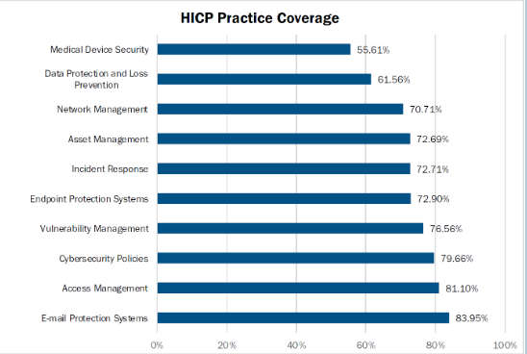
HICP 405(d)
2023 Release – Practice 10: Cybersecurity Oversight & Governance
10.S.A Policies
Provides a list of policies that should be in place
10.S.B Cybersecurity Risk Assessment and Management
Security Risk Assessment
Enterprise Risk Management
10.S.C Security Awareness and Training
Phishing Campaigns
Physical Security, Workstation Security, Security Policy
10.S.D Cyber Insurance
Guidance on selecting coverage
https://405d.hhs.gov

Slide 31
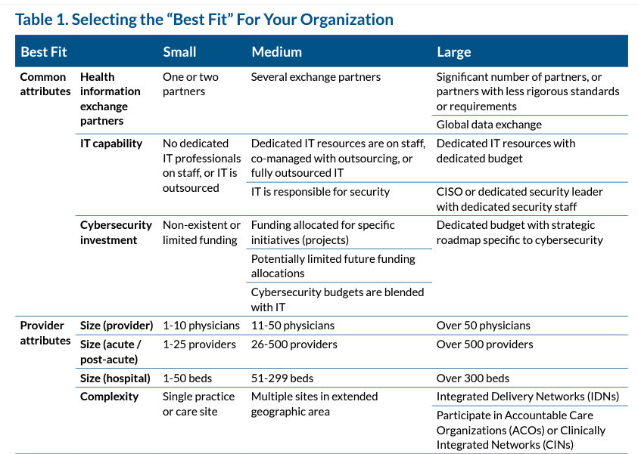
Select Your Organization Size

Slide 32
Recognized Security Practices
Key Takeaways
Voluntary
RSP currently considered 405(d), NIST CSF, or “other”
Does not provide automatic immunity from HIPAA liability, but may be considered mitigating factor in OCR HIPAA Security Rule investigations and audits
Requires sufficient documentation and evidence
Measures must be implemented (not just written) and widely adopted across the enterprise for the previous 12 months to be considered
Notes:
lack of Recognized Security Practices will not be considered an aggravating factor and will not result in increased penalties

Slide 33
AI Security
Notes:
http://pixabay.com/en/keyboard-computer-internet-work-561016/

Slide 34
AI poses a novel challenge because the algorithms often require access to large quantities of patient data, and may use the data in different ways over time!
Notes:
http://pixabay.com/en/startup-start-up-notebooks-creative-593327/

Slide 35
The location and ownership of servers and computers that store and access patient health information for healthcare AI to use are essential in these scenarios
Patient data remain in the jurisdiction from which it is obtained
HIPAA definition of de-identification is that technology now can re-identify that data pretty easily
HIPAA does not directly regulate entities that are in this space unless they're acting as a business associate for a covered entity
Does your organization have any policies on how to handle date and AI, What workforce can and can’t do?
AI Security Things to Think About
Notes:
http://pixabay.com/en/startup-start-up-notebooks-creative-593324/

Slide 36
Questions?

Slide 37
Next Session:
Third Party Vendor Security Best Practices 2024
Tuesday, February 13, 12-1PM
Register for Session 2 Here

Slide 38
Workshop Evaluation Survey
Please share your feedback on this session. This should take less than 3 minutes to complete.

