Slide 1
CHCANYS NYS-HCCN presents
Prep for your Health Center's EHR Transition
June 22, 2022

Slide 2
Housekeeping
All participants have been muted upon entry to prevent any background noise.
Use the chat box to type questions during the session.
The webinar is being recorded.
Slides and recording link will be sent to you following the presentation.

Slide 3
Agenda
Prep for your Health Center's EHR Transition
Making the Decision to Change EHRs
EHR vendor Selection Process
Planning and Implementing an EHR transition
Peer Spotlight: The Chautauqua Center
Resources

Slide 4
Poll
Where is your health center at with transitioning EHRs?

Slide 5
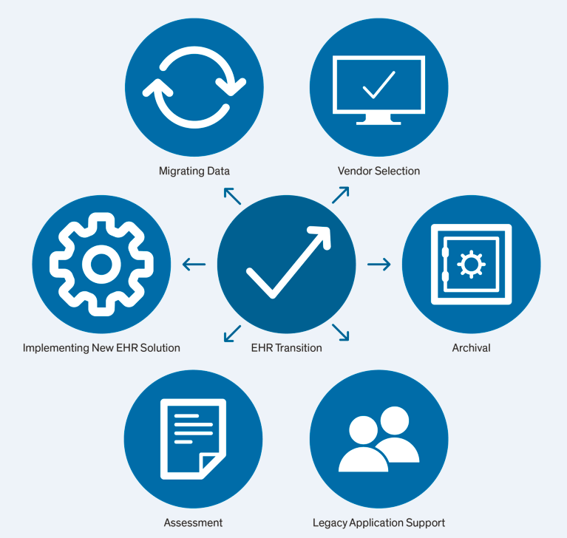
Step-Wise Approach
Deciding whether to switch EHRs
Selecting a new EHR product
Planning and executing EHR transition

Slide 6
Deciding Whether to Change EHRs
Understanding your goals
What are the specific problems with your current EHR?
What are the benefits you're seeking by changing EHRs?

Slide 7
Process
Data
Workflows
Technology
Equipment
Software
Hardware
People
Leadership
Teams
Users

Slide 8
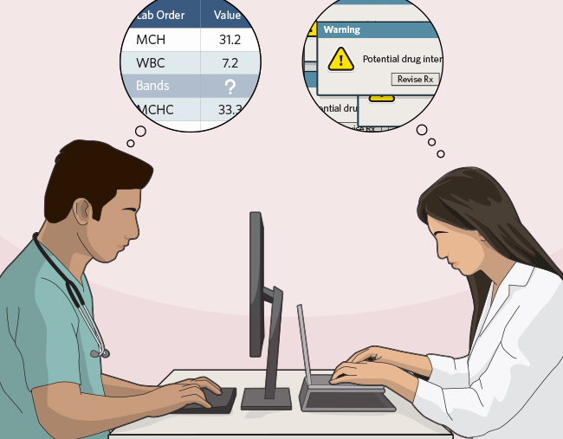
Main Goals
Improved Interoperability
Simplified EHR Operations
More Satisfied and Productive Clinicians

Slide 9
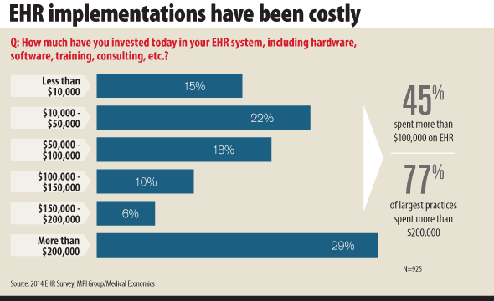
Considering the Financial Impact
System Costs
Licensing fees
Hosting
Productivity and Revenue
Retraining clinicians and staff
Clinical productivity
Billing/collection processes

Slide 10
Considering the Financial Impact
Data migration and capabilities
Data migration fees
Data collection and analytic capabilities
Workflow Changes
Reimplementing EHR customizations
Reimplementing interfaces and other interoperability connections
Other
Patient experience
Staffing needs

Slide 11
Selecting a New EHR Vendor
Request for Proposal (RFP)
EHR Product Options
What specific product features and services do they offer?
What system do your providers prefer?
What is the shortlist of alternative EHRs?
What other recommendations have you received from peer CHCs on alternative systems?
Negotiate a Contract
What pricing and other contractual terms can you negotiate with them?

Slide 12
Most Frequently Used EHR Vendors

Slide 13
NYS FQHC EHR Breakdown

Slide 14
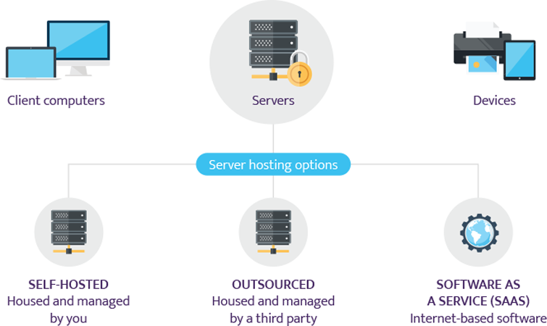
Outsourcing EHR Vendors
Colocation only
Hosting of EHR software
Hosting of EHR software and general EHR-specific application support
Hosting of EHR software, general EHR-specific application support and informatics support for EHR content

Slide 15
Assemble a Multidisciplinary EHR Team
EHR Implementation Team
Team Lead
EHR Implementation Manager
Provider Champion
Nurse/MA/ Front Desk/ Billing Lead
IT Lead
Suer User Lead

Slide 16
Build a Data Governance Committee
Define purpose and goals
Align with organizational goals
Establish Cadence
Assign responsibilities
Find the right folks
Who are the stakeholders?
Think about the variety of skillsets and roles at your center
Ensure aligned data literacy

Slide 17
Poll
EHR & Data Governance Committee

Slide 18
Executing an EHR Transition
Workflow transitions
Changes to existing clinical and administrative workflows
Document current workflows for frequent EHR use cases
Operational slowdown
Fewer visits per day
Absorb reductions in revenue

Slide 19
Executing an EHR Transition
Data migration
Research how much data can be migrated
Perform an inventory of custom structured fields
Timing of launch
Staggered vs All-at-once

Slide 20
Training
Amount of training
Training modules
Proficiency
Timing

Slide 21
Post-Implementation Monitoring
Data quality
Workflow efficiency
Evaluation

Slide 22
Peer Spotlight: The Chautauqua Center
Kristy Lauer, LCSW-R | Chief Clinical Officer
Melissa Ramsey | Clinical Data Coordinator
Brian Collopy | IT Director

Slide 23
The Chautauqua Center
Kristy Lauer- Clinical Director, LCSW-R
Melissa Ramsey- Clinical Data Coordinator
Brian Collopy | IT Director

Slide 24
About Us
The Chautauqua Center is a Federally Qualified Health Center (FQHC)
Our Mission
To deliver comprehensive high-quality patient-centered health and support services in the Chautauqua region
Our Vision
Our core principles are access, treatment, education, and prevention delivered by friendly and professional clinic and administrative teams.

Slide 25
Process
Generate RFP for new EMR
Administrative team reviewed all RFPs received
Selected four vendors to provide demos (ECW, Athena, Allscripts, Medent)
Selection committee- staff from each area of the organization that would be utilizing the system in different ways
Created a universal scoring sheet that each committee member completed at each demo
Took the top two scored vendors to do a further in-depth demo with the admin team
Admin team selected which vendor was chosen

Slide 26
Preparing and Implementing the Transition
Selected the project lead
Selected the team members that would be responsible for each section of the implementation (clinical, IT, finance/registration, quality reporting)
Started pre-implementation phase
Created all agency users
Sent them all trainings to complete more than two months before implementation date (this is very important- need to give staff time to do this!)
Each of the team members needs to complete tasks timely
Needed to identify process for merging records into new EMR (may require contract with another vendor).

Slide 27
Post Implementation Work
Set all providers up with coaching calls as soon as possible (don’t wait!)
Implementation team should continue to meet weekly to ensure things are working as intended
Review reports from EMR vendor if applicable to see how each user is doing in the system
Ensuring everyone is on board with this change- talk in a positive nature regarding the change (this is critical when staff are disillusioned with change)
Find a physician champion
Need to adjust our workflows to reflect the processes in the new EMR.

Slide 28
Challenges/Lessons Learned
Pre-implementation training is critical for success
Utilizing EMR self-helps to learn about the system is extremely helpful
Utilize your Customer Service Representative- ask questions (there are no stupid questions with a new system!)
In-person trainings versus virtual
Need to do post-training to fine tune to our customizations

Slide 29
Highlights/Promising Practices
Reports- ability to create reports, canned reports, links to all the quality reports (i.e., UDS, PCMH, MU)
Having an FQHC team- our support team is FQHC trained and specialized
Having a separate Quality tab in patient’s chart- easy to manage during patient visit
Self help ability- less reliance on a ticketing system
Pre-built encounter plans and templates- web based EMR
Support groups with other users via Athena platform
Beta testing opportunities and spring, summer, fall updates

Slide 30
Recommendations
Solid plan of who will review the demos- needs to be a bottom-up model as they are at the patient level
Select a strong team lead that has the power to hold others accountable
Schedule time for pre-implementation training for all staff
Need staff buy in- need your staff to accept the change and be involved
Need to know exactly what you want to achieve and what your needs are to be successful (i.e results delivery- interfaces)

Slide 31
USB Devices
Credit Card Scanning Software is finicky, we’ve licensed a 3rd party product that consumes a lot of troubleshooting.
Users need to be aware of how to use and troubleshoot USB devices as their credit card machines, card scanners are both USB. These aren’t as smooth as you’d hope.
We use a licensed ScanSharp application for each device connected to a scanner that interfaces with their Athena ADM software.
These two pieces of software can get tangled up easily if staff doesn’t log out or understand the order of operations in troubleshooting USB devices on the fly.
Leveraging Athena’s API for functionality with our phone system and interfaces

Slide 33
Resources
KLAS Research: 2022 Best in KLAS
Health Information Technology Evaluation and Quality Center (HITEQ)
EHR Vendors Most Frequently Used by Health Centers
Creating a Leadership Team for Successful EHR Implementation
Build a Data Governance Team/Committee
Seamless EHR Transition Through Data Migration
Electronic Health Records ONC Playbook

Slide 34
EHR Resources
EHR Portal and Account Manager
CHCANYS EHR User Groups
eClinicalWorks (monthly meetings)
athenaOne & MEDENT (quarterly meetings)
NextGen (bi-monthly meetings)
NACHC EHR User Groups
NextGen, eClinicalWorks, athenaPractice, Greenway Intergy, athenaOne, EPIC

Slide 35
EHR Transition Webinar Evaluation Survey
Please share your feedback on these sessions. This should take less than 3 minutes to complete.
Survey Link: https://forms.office.com/r/JqiTrtvUEk
For any questions, please email Apsara Ahmed at aahmed@chcanys.org

