Slide 1
Health Equity & Data Collection
Jamila Michener, PhD
Associate Professor of Government and Public Policy
Co-director, Cornell Center for Health Equity
@povertyscholar

Slide 2
Health Equity at the Forefront

Slide 3
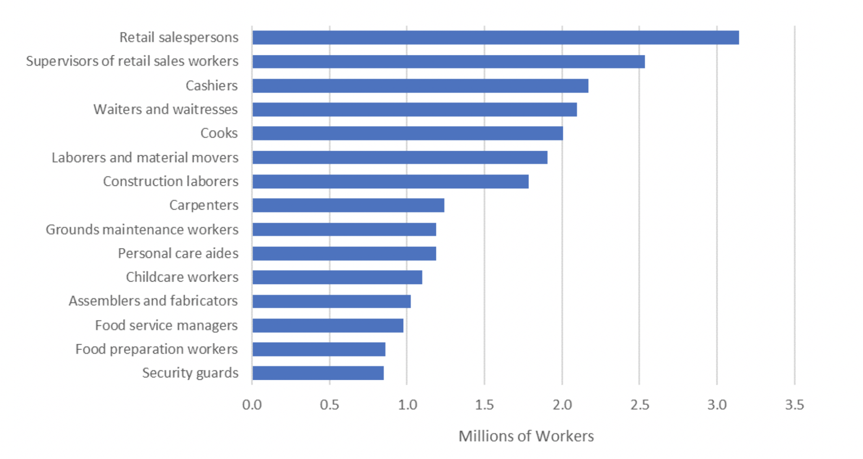
Health Equity at the Forefront
Notes:
https://www.philadelphiafed.org/community-development/workforce-and-economic-development/which-workers-will-be-most-impacted

Slide 4
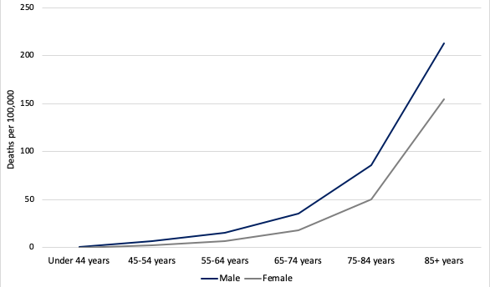
Health Equity at the Forefront
Notes:
https://www.brookings.edu/blog/up-front/2020/05/15/covid-19-much-more-fatal-for-men-especially-taking-age-into-account/

Slide 5
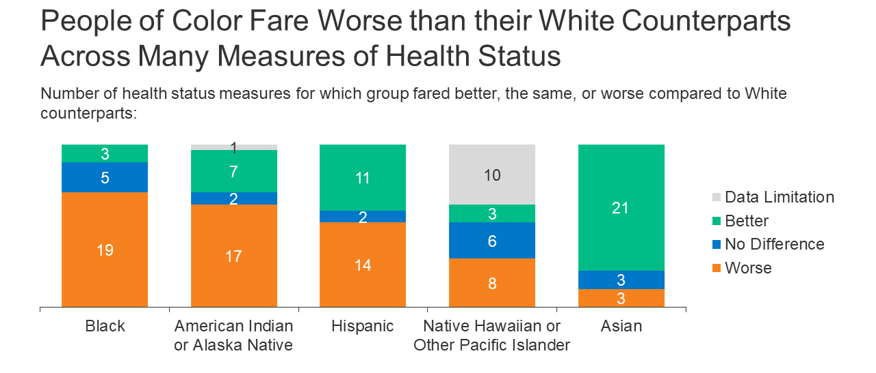
Health Equity at the Forefront
Notes:
https://www.kff.org/racial-equity-and-health-policy/issue-brief/disparities-in-health-and-health-care-5-key-question-and-answers/

Slide 7
Notes:
https://www.kff.org/coronavirus-covid-19/press-release/early-covid-19-vaccination-efforts-through-community-health-centers-are-reaching-people-of-color/

Slide 8
Health Equity
Health equity means that everyone has a fair and just opportunity to be as healthy as possible. Achieving this requires removing obstacles to health such as poverty and discrimination and their consequences, which include powerlessness and lack of access to good jobs with fair pay; quality education, housing, and health care; and safe environments.
Health equity is the ethical and human rights principle that motivates people to eliminate disparities in health and in the determinants of health that adversely affect excluded or marginalized groups. Progress toward health equity is measured by reductions in health disparities.

Slide 9
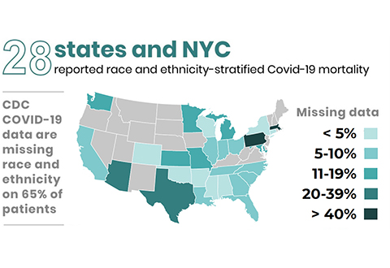
Health Equity & Data
Notes:
https://www.cherp.research.va.gov/features/COVID_19_Health_Disparities_Reporting.asp

Slide 10
Notes:
Covid Tracking Project: https://covidtracking.com/race/dashboard

Slide 11
Data can Identify Systems Level Problems

Slide 12
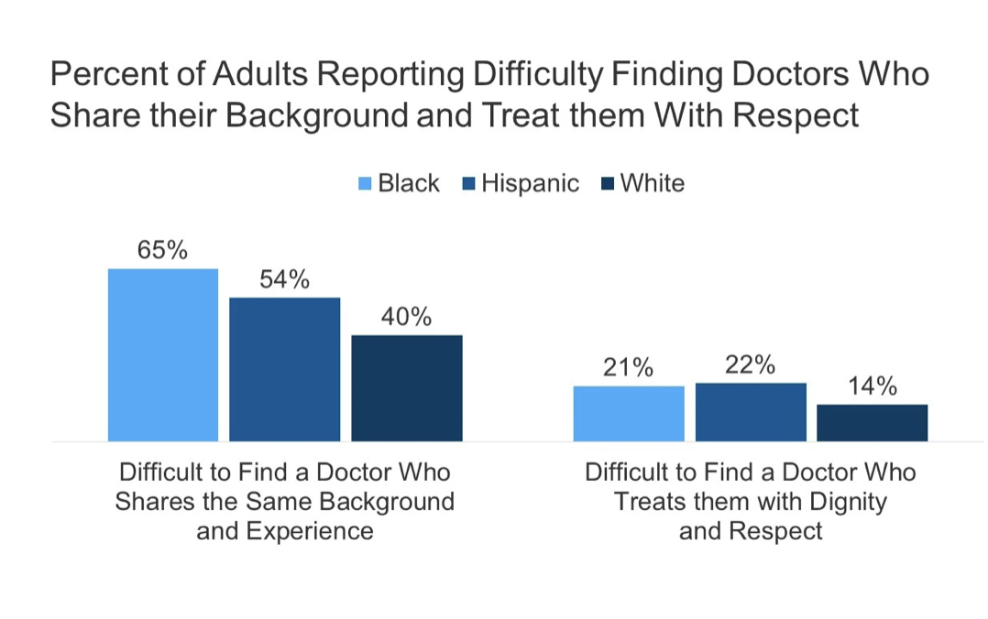
Data can Identify Systems Level Problems

Slide 13
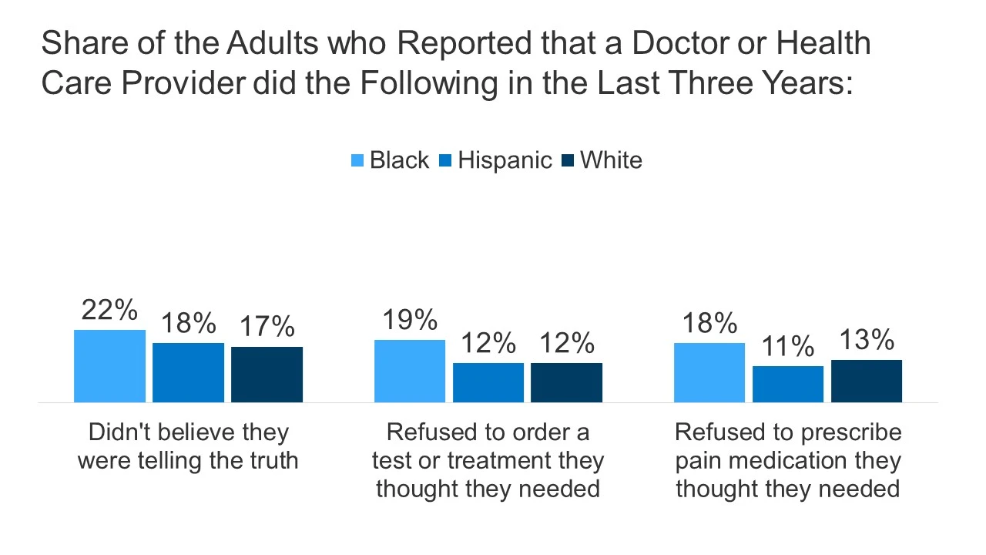
Data can Identify Systems Level Problems

Slide 14
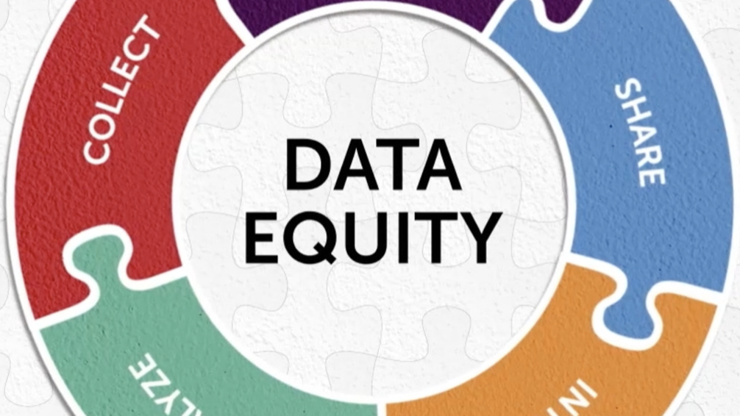
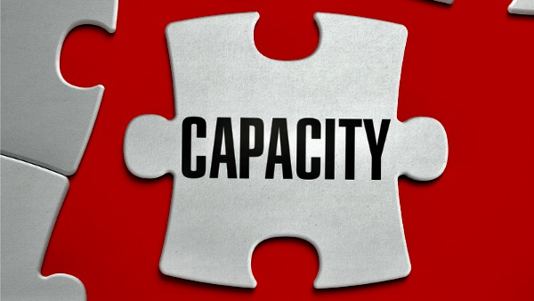
But...Data is Challenging

Slide 15
Identifying Problems
Targeting Resources
Making Change

