Slide 1
A Path Forward: Reflections after a Decade of Gathering Granular Ethnicity Information from Patients in a Community Health Care Setting
Elizabeth Lever, MS, Chief Information Officer
Institute for Family Health

Slide 2
The Institute for Family Health
The mission of the Institute for Family Health is to improve access to high quality, patient-centered primary health care targeted to the needs of medically underserved communities.
In support of its mission, the Institute: Addresses barriers to health equity to eliminate racial and ethnic disparities in health outcomes

Slide 3
Topics
Federal Standards as External Context
Institute Categories: Race, Ethnic Group and Granular Ethnicity
Information Gathering: Principles and Process
Evaluating the Process and Identifying Impact

Slide 4
Federal Standards
Government-wide standard, issued in 1997 by Office of Management and Budget (OMB): Statistical Policy Directive No. 15, Race and Ethnic Standards for Federal Statistics and Administrative Reporting
five minimum categories for data on race: American Indian or Alaska Native, Asian, Black or African American, Native Hawaiian or Other Pacific Islander, and White.’
two categories for data on ethnicity: "Hispanic or Latino" and "Not Hispanic or Latino.”
‘To provide flexibility and ensure data quality, separate questions shall be used wherever feasible for reporting race and ethnicity. When race and ethnicity are collected separately, ethnicity shall be collected first.’
Census Bureau:
General purpose and broad application of the federal standards
Conducts extensive survey methodology research; best practices are commonly adopted
For over 10 years, evaluation has included, specifically, the most effective way to gather self-reported race and ethnicity information (including using a single question that includes Hispanic origin as a response option with the list of races)
Notes:
https://obamawhitehouse.archives.gov/omb/fedreg_1997standards
Suggested Citation: Erica L. Olmsted-Hawala, Elizabeth M. Nichols. (2020). Usability Testing Results Evaluating the Decennial Census Race and Hispanic Origin Questions Throughout the Decade: 2012-2020. Research and Methodology Directorate, Center for Behavioral Science Methods Research Report Series (Survey Methodology #2020-02). U.S. Census Bureau. Available online at <http://www.census.gov/content/dam/Census/library/working-papers/2020/adrm/rsm2020- 02.pdf>

Slide 5
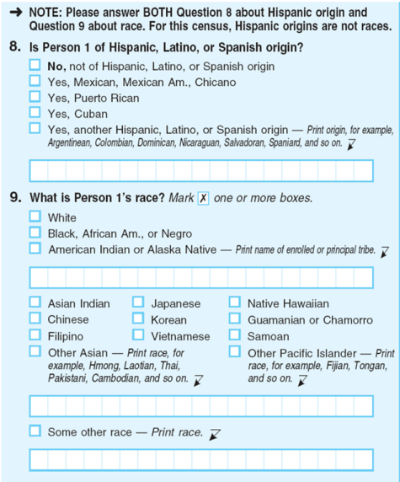
Federal Standards
Department of Health and Human Services Implementation Guidance on Data Collection Standards for Race, Ethnicity, Sex, Primary Language, and Disability Status (2011):
“standards based on the disaggregation of the OMB standard used in the American Community Survey (ACS) and the 2000 and 2010 Decennial Census (emphasis added).”
2010 Census question format at right
Health Resources and Service Administration, Bureau of Primary Health Care: Uniform Data System Reporting Requirements for 2021 Health Center Data:
”UDS classifications are consistent with those used by the Census Bureau and HHS implementation guidance above.”
Notes:
CDC Race and Ethnicity Code Set Version 1 (March 2000)
Agency for Healthcare Research and Quality
Office of the national coordinator for health information technology: CDC Race and Ethnicity Code Set Version 1.0 (March 2000), and § 170.207(f)(1) The Office of Management and Budget Standards for Maintaining, Collecting, and Presenting Federal Data on Race and Ethnicity, Statistical Policy Directive No. 15, as revised, October 30, 1997
The “Race & Ethnicity—CDC” code system in PHIN VADS (at a minimum, Release 3.3.9) permits a much more granular structured recording of a patient's race and ethnicity with its inclusion of over 900 concepts for race and ethnicity. The recording and exchange of patient race and ethnicity at such a granular level can facilitate the accurate identification and analysis of health disparities based on race and ethnicity.

Slide 6
Institute: Race
** Bold and Underlined Text: Option for Selection in EHR
Asian - OMB minimum; UDS
Native Hawaiian or Other Pacific Islander - OMB minimum; UDS reporting requires distinct categories:
Native Hawaiian
Other Pacific Islander
Black or African American - OMB minimum; UDS
American Indian or Alaska Native - OMB minimum; UDS
White – OMB minimum; UDS
More than One Race – UDS: “use this line only if your system captures multiple races (but not a race and an ethnicity) and the patient has chosen two or more races.”
Unreported/Refused to Report Race - UDS
Some Other Race – Census
Declined - Institute forms use the term: “Prefer not to say”
Not Collected/Unknown

Slide 7
Institute: Ethnicity
** Bold and Underlined Text: Option for Selection in EHR
Ethnic Group:
Hispanic or Latino - OMB minimum
Not Hispanic or Latino - OMB minimum
Unreported/Refused to Report Ethnicity - UDS
Declined - Institute forms use the term: “Prefer not to say”
Not Collected/Unknown
Granular Ethnicity: “What is your ethnic background or ancestry? (You can write as many as four)”
Over 500 options
Implemented in 2010 based on IOM (Institute of Medicine). 2009. Race, Ethnicity, and Language Data: Standardization for Health Care Quality Improvement. Washington, DC: The National Academies Press. https://www.ahrq.gov/sites/default/files/publications/files/iomracereport.pdf

Slide 8
Information Gathering
Self-Reported Race and Ethnicity is widely considered the gold-standard
Institute team members are trained to “never assume, always ask”
Prompts in the Electronic Health Record to gather Race, Ethnicity and Granular Ethnicity reinforce this standard
Patient does not have updated information on Race, Ethnicity and Granular Ethnicity. Remember: NEVER ASSUME, ALWAYS ASK!

Slide 9
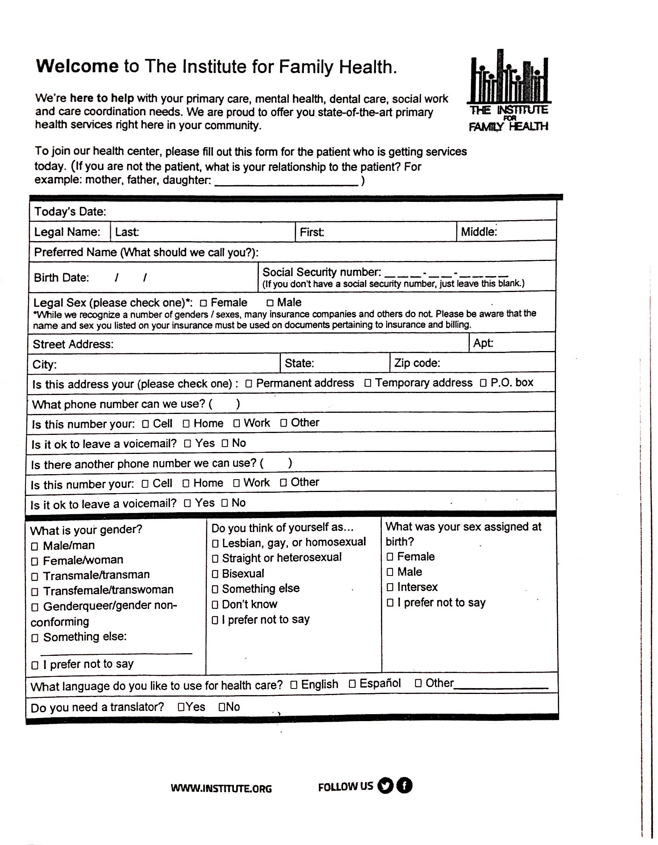
Information Gathering
Established: “Demo Intake Form”
Individuals completes the form on paper
Available in English and Spanish
Includes: Race, Ethnicity, Granular Ethnicity, Country of Origin along with Language and translation needs
Information entered into specified fields in the EHR
Paper form scanned into the record
Emerging: “Virtual Front Desk” workflows / self-service e-Registration and e-Check-in
Notes:
– Allows the ultimate flexibility in formatting and presentation

Slide 10
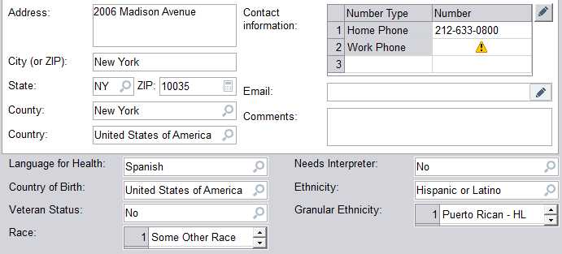
Accuracy?
Does this information provided vis the paper form match the information entered into the electronic health record?

Slide 11
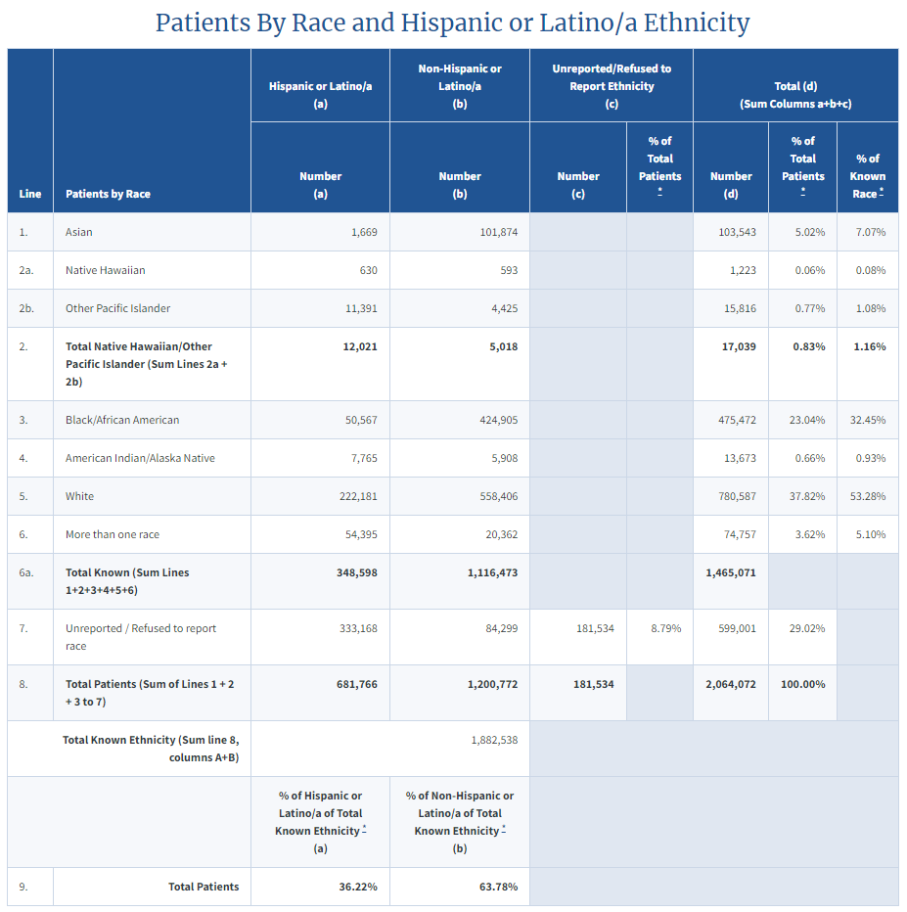
Completeness?
Line 7:
“Unreported/Refused to Report Race” and
Column C: “Unreported/Refused to Report Ethnicity”
New York State 2020 UDS Data Table 3B: Demographic Characteristics https://data.hrsa.gov/tools/data-reporting/program-data/state/NY/table?tableName=3B
Notes:
2019 UDS (Pre-Pandemic):
95% of Patients reported Race or Ethnicity
Only 5% of Patients fell into both “Unreported/Refused to Report Race” and “Unreported/Refused to Report Ethnicity”
2020 and 2021:
Doubled: 10% of Patients fell into both “Unreported/Refused to Report Race” and “Unreported/Refused to Report Ethnicity” groups
Virtual Front Desk?
Electronic- Registration and Check-in?

Slide 12
How effectively does the information serve its purpose?
"eliminate racial and ethnic disparities in health outcomes” – Institute Mission Statement
"the need to identify and address quality differentials not simply to collect information to classify and count people.” – AHRQ report

Slide 13
Race and Ethnicity
Separate questions for Race and Ethnicity are the result of the federal standard
Limitations to this approach are well-established (not only about the “data”)
"One of the critical findings from the 2010 AQE qualitative focus group research illuminated that most Hispanics preferred to identify as Hispanic only, and when faced with answering the race question, most either skipped the race question entirely or provided an answer which they noted in focus group discussions did not reflect how they would prefer to self-identify (such as reporting White).”
2015 National Content Test Race and Ethnicity Analysis Report: https://www2.census.gov/programs-surveys/decennial/2020/program-management/final-analysis-reports/2015nct-race-ethnicity-analysis.pdf
Notes:
OMB To provide flexibility and ensure data quality, separate questions shall be used wherever feasible for reporting race and ethnicity. - https://obamawhitehouse.archives.gov/omb/fedreg_1997standards
2015 National Content Test Race and Ethnicity Analysis Report https://www2.census.gov/programs-surveys/decennial/2020/program-management/final-analysis-reports/2015nct-race-ethnicity-analysis.pdf: This is the giant report I was talking about that did very in-depth testing of the census questions in advance for 2020. As I mentioned, there are many articles and data that established the validity issues with Race and Ethnicity being asked about in two questions in the United States; but this is the "gold standard" of the research on it.
"5.1 Analysis of Alternative Question Formats (Separate vs. Combined)" starts on page 41 and concludes:
"Of those who provided a Hispanic response, significantly higher percentages used only the Hispanic category to report this response when responding using the combined question approaches compared to the Separate Questions approach, and significantly lower percentages used the Hispanic category in addition to a race category (e.g., White or SOR). This suggests that when there is a Hispanic category present in the race question, Hispanic respondents do not need to use ot​her categories to report their Hispanic identity."

Slide 14
Granularity
“While there are hundreds of possible ethnic categories, not all will have local relevance nor always have added value for designing targeted approaches to remediate health care needs”
Notes:
The subcommittee adopts the term granular ethnicity to describe groups at a more specific level of categorization than the broad OMB categories, such as the ethnic groups that the Census lists as subgroups in its Hispanic ethnicity and race questions.
he level of detail for analysis for quality improvement can be influenced by the size of the ethnic population under study; the number or proportion of those ethnicities that might have a specific condition such as diabetes or be of an age at which immunization for pneumonia is needed; and the actual associations among ethnicity, other correlated factors (e.g., income, insurance coverage), and quality of care. While there are hundreds of possible ethnic categories, not all will have local relevance nor always have added value for designing targeted approaches to remediate health care needs. This report's recommendations are driven by a need to identify and address quality differentials not simply to collect information to classify and count people.

Slide 15
A Path Forward: Current Considerations
How do we “localize” best-practices to the communities we serve (and balance the ability to meet external standards)?
Can we improve the individual experience of sharing this information?
What is the most effective interpretation of the information that has been shared with us?
How can we use our technology to promote “meaningful use” of the information that has been shared?
Can we (and should we) establish a standard “Single-Variable Interpretation”?

